Slide 1
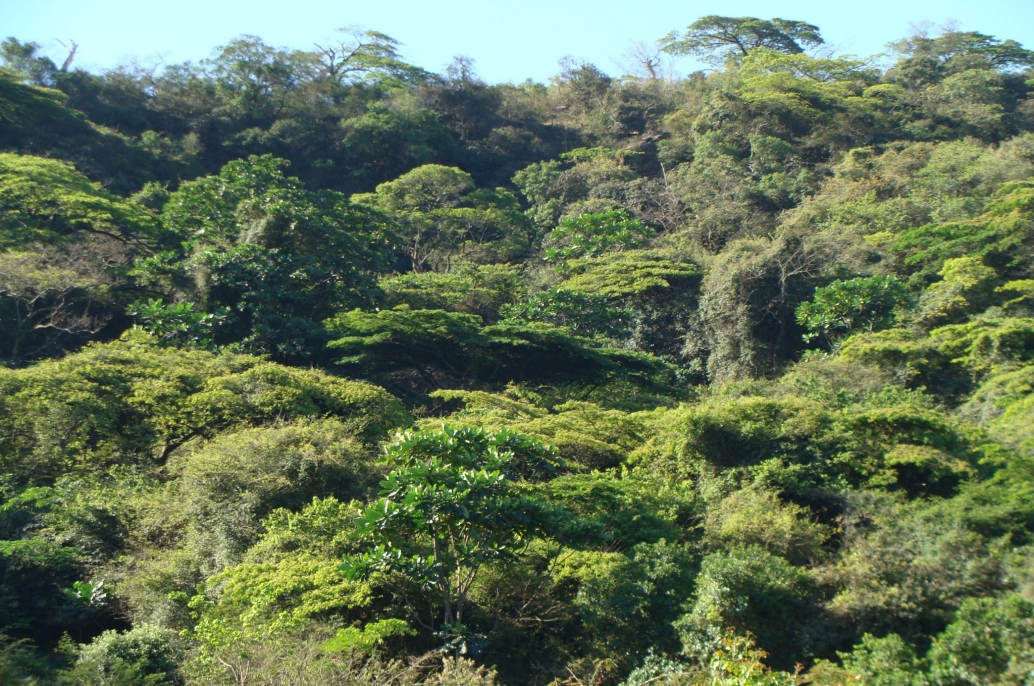
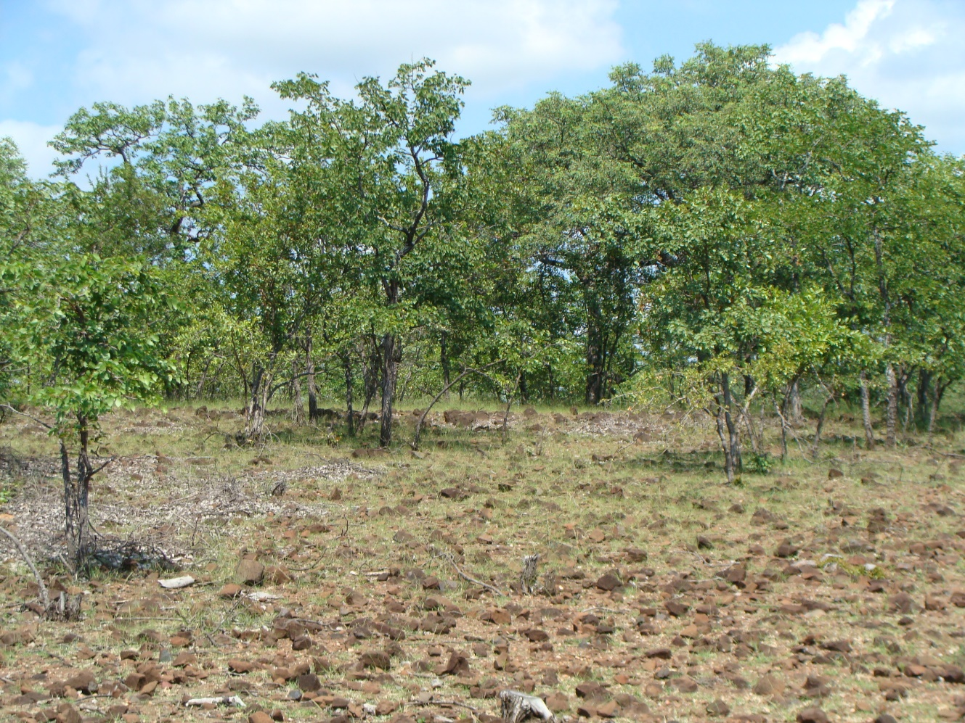
Exploring the role of provisioning services in households’ response to vulnerability in the dry woodlands of Venda, South Africa
Fiona Paumgarten
Notes:
Rural households in southern Africa’s dry forests and woodlands are inherently vulnerable, exposed to multiple stressors. To sustainably manage this vulnerability, many households depend on the goods and services (including provisioning services) the surrounding ecosystem provides. These provide direct benefits, indirect benefits, income-generating opportunities, safety-net functions and possibly contribute to climate change adaptation. Ecosystem change and loss may increase vulnerability, threatening sources of food, raw materials, water and medicine. It is argued that the provisioning services concept can be used to support conservation and livelihood improvements.
This research presents some of the initial findings from my PhD research.

Slide 2
Objective: Exploring the role of provisioning services in households’ response to vulnerability in the forests and woodlands of Venda, South Africa, with a focus on climate variability and change.
Aims:
To understand vulnerability to multiple stressors (including climate variability & change) amongst rural households in Venda
To understand responses to multiple stressors (including the role of provisioning services) in helping households cope with climate variability and change.
To explore scenarios of future change, with a focus on climate change, and the potential role of provisioning services in helping households adapt in order to maintain a sustainable livelihood
Notes:
The research explores the role of provisioning services in households’ livelihoods, particularly in their response to vulnerability in the woodlands of Venda, Limpopo Province, South Africa. Multiple stressors were considered, including climate variability and change. Past incidences of droughts and floods are explored. Conversely, the impact of increased vulnerability on provisioning services was examined. The ongoing research aims to explore future climate change scenarios and the role of provisioning services in household adaptation practices
This research aims to contribute towards the growing dialogue on CC adaptation focusing particularly on the role of forests & woodlands in the adaptation strategies of rural households in South Africa.

Slide 3
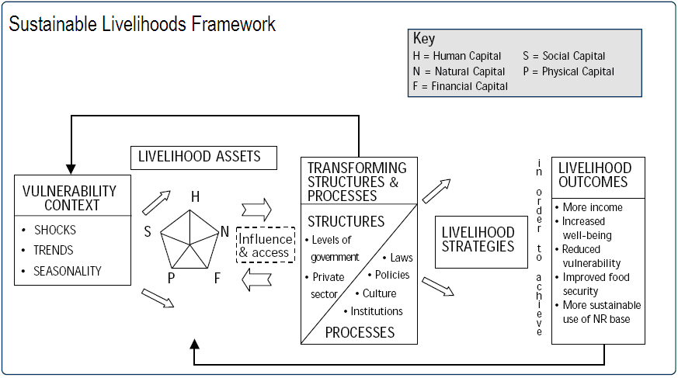
Notes:
The Sustainable Livelihoods Framework remains a popular framework for exploring rural livelihoods, including household strategies and assets, households vulnerability context, as well as their proposed livelihood outcomes. How these dimensions are analysed, is determined by the objectives of the research. The results presented here are considered specifically through a climate lens with a focus on the role of provisioning services in rural livelihoods in general and in response to vulnerability in particular. This role in reducing vulnerability and helping households cope has been gaining increasing attention in the climate change agenda, particularly with respect to adaptation.
Provisional findings. Climate as a variable needs to be compared to other variables, such as wealth, gender, etc.
Rural households are exposed to a range of shocks, trends and seasonal fluctuations over which households have limited or no control.
Households in both villages were interviewed about the shocks, trends and seasonality to which they are vulnerable. Multiple stressors were identified in both sites. This data is still in the process of being analysed.
While climate variability and change may not always be the most important stresses affecting a specific community, they should be considered, particularly in communities characterised by climate sensitive and/or natural resource dependent livelihoods

Slide 4
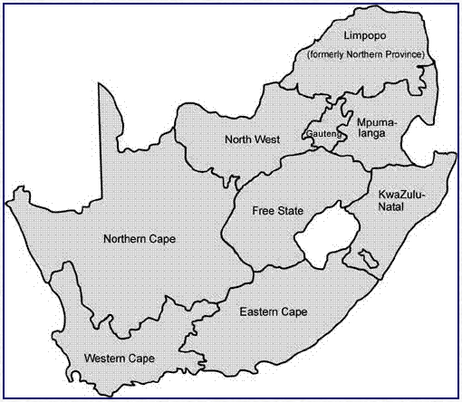
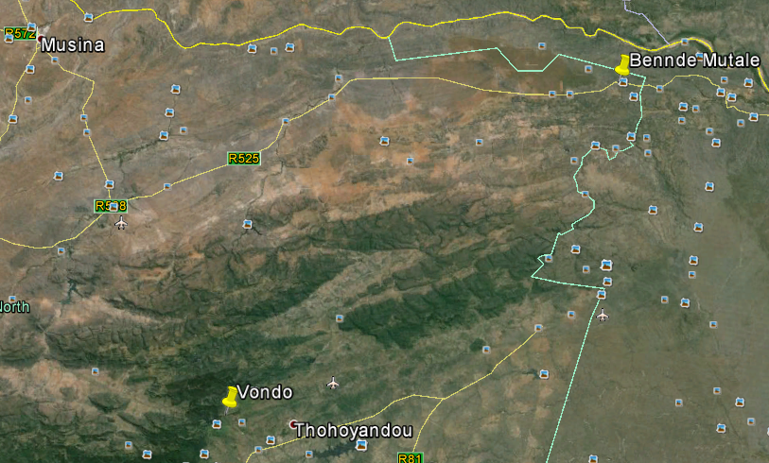
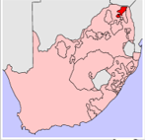
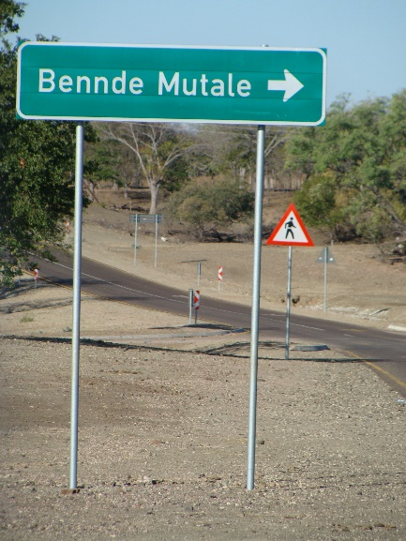
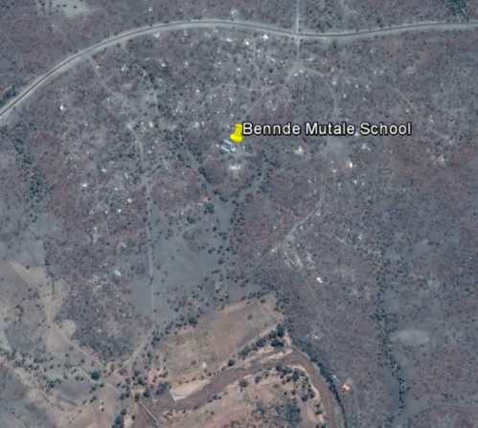
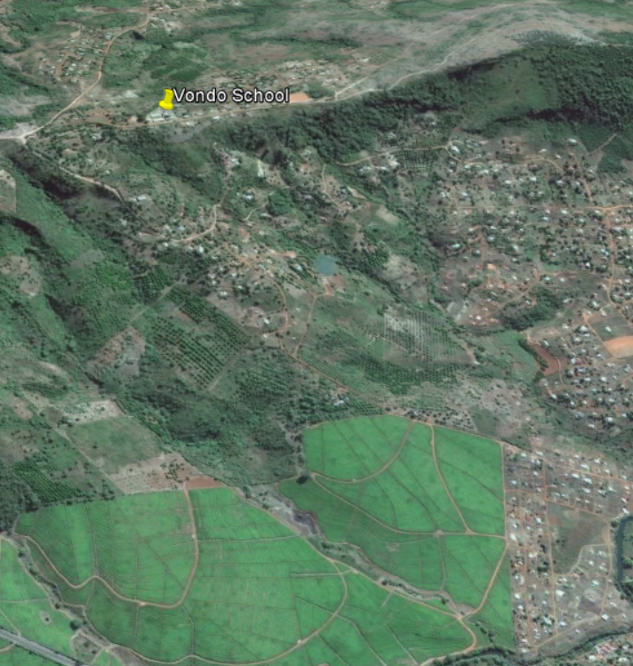
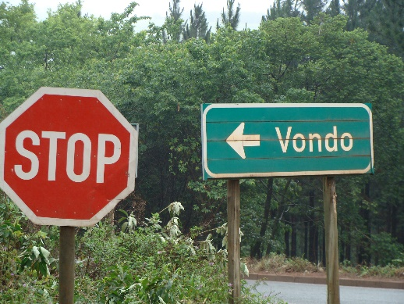
Dry Site
Wet Site
Study Sites
Notes:
The research was conducted in 2 villages, both in Venda, Limpopo Province. The villages fall within different rainfall zones, with one receiving notably less annual rainfall than the other. Although only about 90km apart. Selecting sites with different annual rainfall, was intended to test how provisioning services, livelihood strategies, vulnerability, coping and adaptation strategies, might differ according to past, present and future climate variability and change.
170 households interviewed - 85 households in each village and several community workshops were conducted. Participatory approach key to understanding local vulnerabilities & capacity for adaptation. PRA exercises included historical profiles, seasonal calendars, time trend exercises, problem tree and impact chain exercises.
Venda, formerly designated as a homeland by South Africa’s previous apartheid govt, still bears the scars of its history and is characterised by poor service provision, low levels of development and, a reliance on a variety of livelihood strategies including arable agriculture, animal husbandry, formal and informal employment, government grants and the use and sale of natural resources.

Slide 5
Livelihoods
Arable Agriculture | Dry site | Wet site
Households with fruit trees (%) | 77,80 | 92,60
Hh with indigenous fruit trees (% of tree growers) | 74,10 | 0,00
Hh with exotic fruit trees (% of tree growers) | 20,40 | 92,60
Notes:
Households in both communities engage in a diversity of livelihood strategies. Similar proportions of households engage in the respective off-farm livelihood strategies but there are differences in the land-based strategies. Not with NTFPs but with arable agriculture and animal husbandry in particular.
Engaging in diffierent livelihoods opens people up to a specific set of opportunities and challenges.
These findings suggest past adaptations to climate but questions are raised as to whether they will withstand future changes. Multiple stressors were identified at the household and community levels including historical and seasonal changes in the availability and use of provisioning services.
Not only are there differences between the land-based strategies, but also differences within each strategy. For example….
Surrounding land uses vary – conservation and NTFP collection vs. tea & timber plantations

Slide 6
Rank | Dry site | Wet site
1st | Government grants | Fields
2nd | Local employment | Government grants
3rd | Migrant employment | Employment
4th | NTFPs | Self-employment
5th | Small stock | Gardens & migrant employment
6th | Cattle | ---
7th | Self-employment | Small stock
8th | Gardens | Cattle
9th | Fields | NTFPs
Notes:
Livelihood ranking

Slide 7
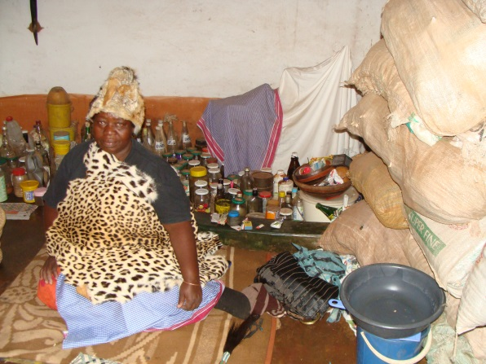
Provisioning Services
Provisioning services include:
Natural medicines
Fuel
Fibre
Food – wild fruits, wild herbs, bushmeat
Freshwater
1. Natural medicines
Notes:
Renowned traditional healer.
Less competition from livestock – overgrazing
Pockets of forests have been maintained – important cultural links to forests and forests & water sources in particular.
Travels distances to collect.

Slide 8
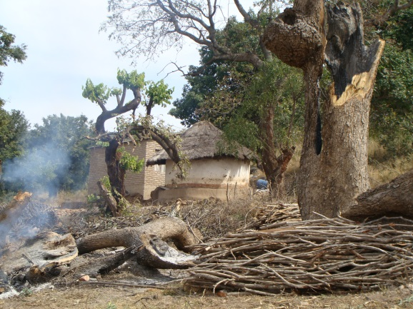
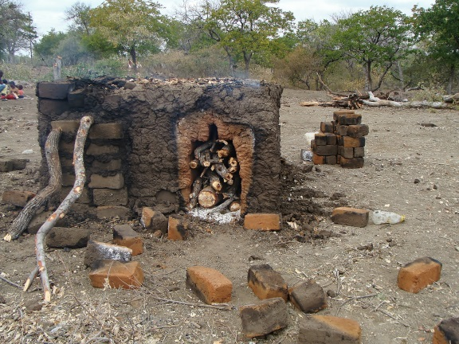
2. Fuel
 | Dry site | Wet site
Collecting takes more time | 93,33 | 88,41
Enough firewood | 14,70 | 14,49
Although over 90% of households in both sites have access to electricity, fuelwood is still the primary fuel.
Availability is a concern in both sites.
Notes:
Vondo – only remnants of forest (sacred sites). Land conversion. Regulations on harvesting fresh wood. Shift away to collecting wood from exotics.
Bennde – also rules on harvesting fresh wood and increasing pressure on the dry wood resources especially since several households engage in the sale of wood and outsiders come into the area to harvest, leaving with truck & trailer loads.

Slide 9
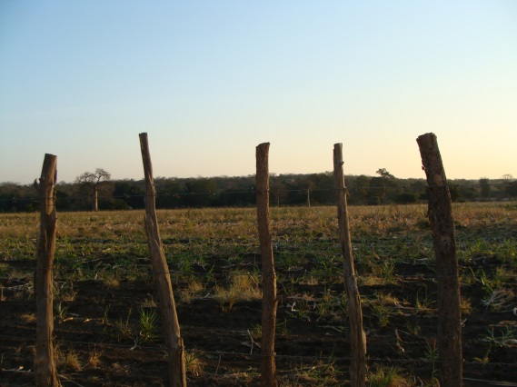
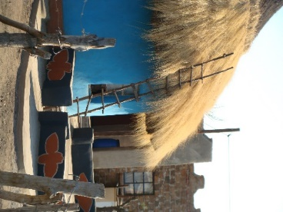
3. Fibre, building materials, etc.
Notes:
Fibres including wooden poles for fencing and construction and grass for roofing, are far more important in the dry site where many households still live in traditional structures. In the wet site, declining availability of resources, easier access to urban centres, government housing programs has seen a shift to metal roof sheets (although many households still make their own bricks). Fencing for livestock enclosures less necessary given lower proportion of households with livestock.
Here again however there are issues with ongoing availability. For example, with grass for roofing there is competition with livestock and many of the old collecting areas fall within the Kruger National Park.

Slide 10
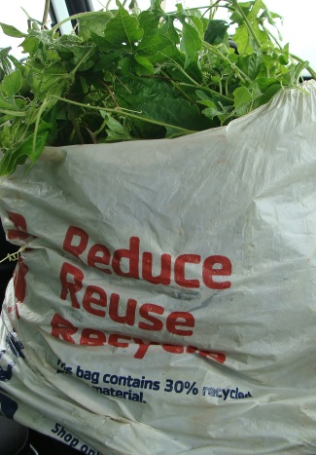
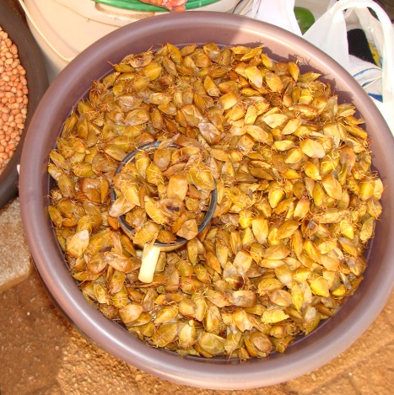
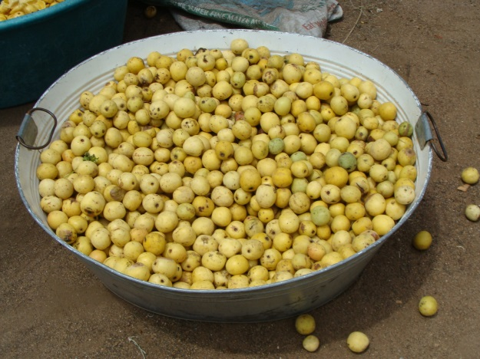
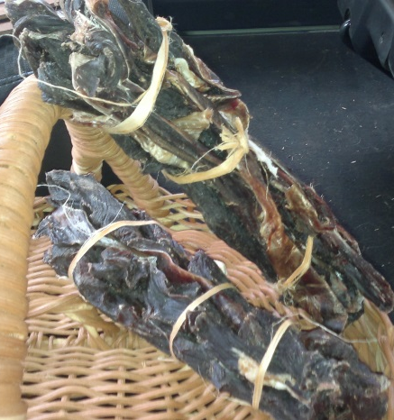
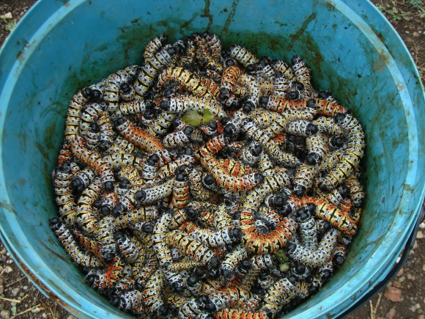
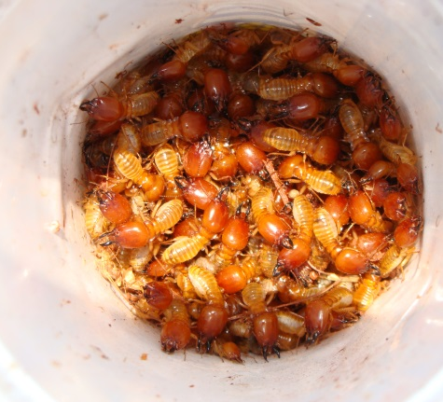
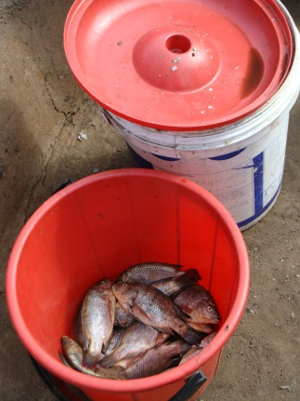
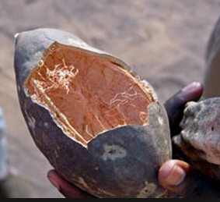
4. Food
More than 90% of households in both villages reported the consumption of wild foods
MOROGO
SHIELD BUGS
MARULA
BUSHMEAT
MOPANE WORMS
TERMITES
FISH
BAOBAB

Slide 11
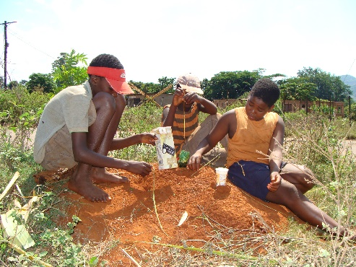
4. Food
Notes:
Wild food makes contributes to households in both sites. Most noticeable difference is with bushmeat.
Issue of availability – wild herbs eaten by over grazing cattle, fruits washed away in floods, bushmeat (issue of poaching and illegality).

Slide 12
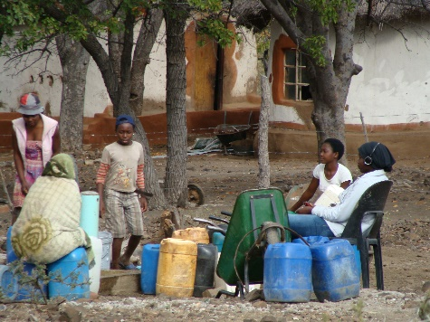
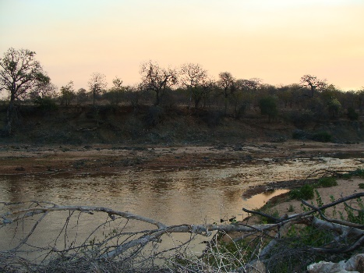
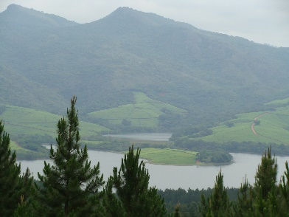
5. Water
For households, agriculture & livestock
Primarily rain-fed agriculture
Wet site – rainfall sufficient
Dry site – requires water storage (75,9% households irrigate from buckets vs. 11,1% in wet site)
Nature of cultivation has been influenced by rainfall, temperature and access to water – e.g. in dry site, greater % plant homegardens in winter when it’s cooler. Homegardens are small and irrigated from buckets.
 | Dry site | Wet site
Water storage (% hh) | 97,7 | 95,3
Increased collection time (% hh) | 25,9 | 76,5
Regularity of supply | 5,9 | 36,5
Notes:
Issue of river & springs drying
Dependence on rainfall
Collect from rainfall but also from communal taps but this supply is variable – poor infrastructure, cost of diesel, etc.

Slide 13
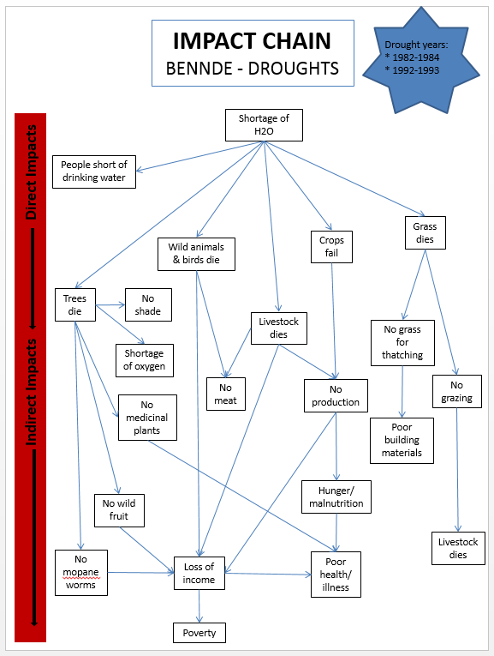
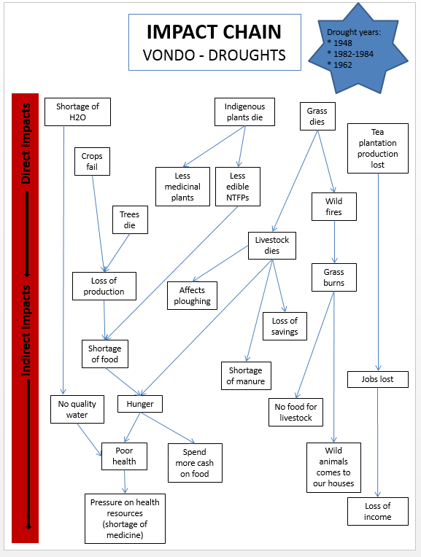
Drought impacts & provisioning services
Notes:
Impacts on water availability, livestock loss, NTFP availability, food availability, crop production, grazing, disease & death, wild fires, trees & grass die, increased conflict with wildlife

Slide 14
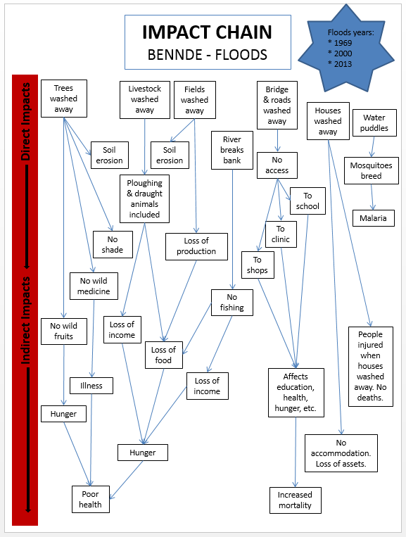
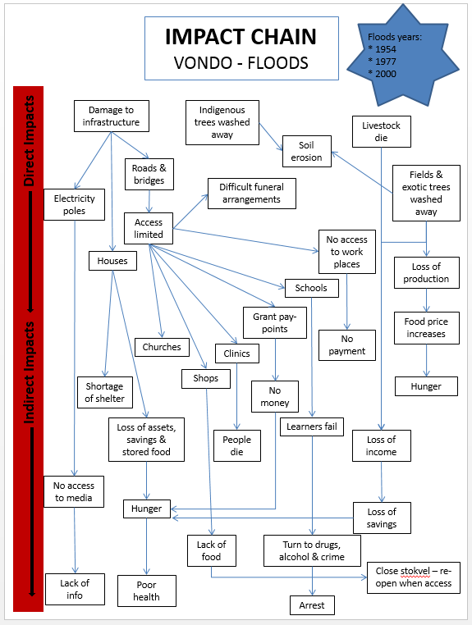
Flood impacts & provisioning services
Notes:
Impacts include: fences washed away, irrigation pipes/pumps washed away, crops washed away, top soil washed away, lives lost, increased disease, livestock lost & diseased, access restricted, electricity supply disrupted, houses/buildings damaged, fruit trees washed away, grazing damaged, roads/bridges washed away, water sources affected

Slide 15
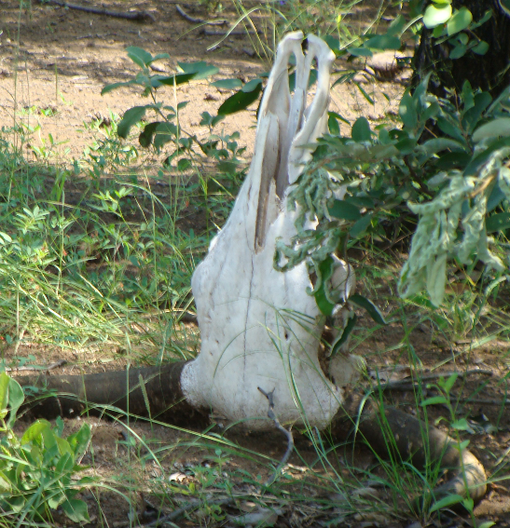
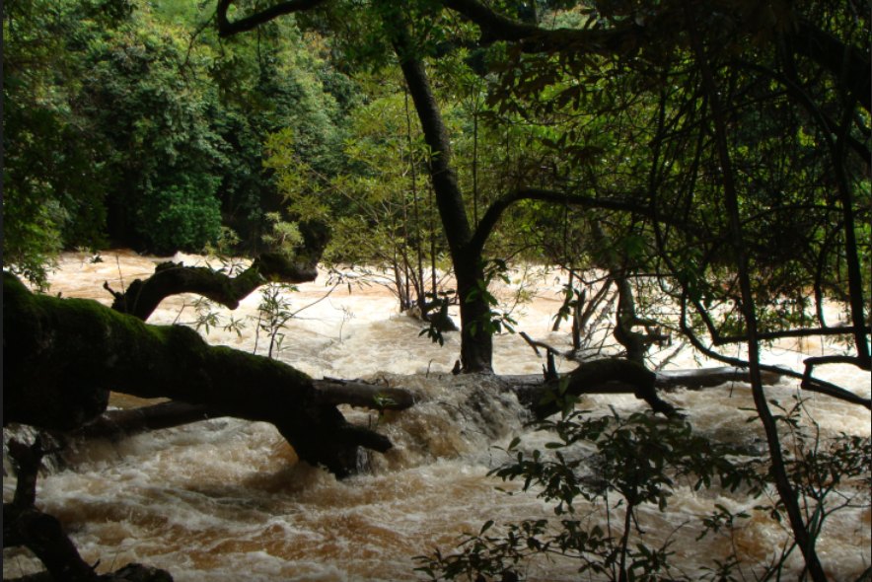
Planning for future droughts & floods – what role for provisioning services?
Government support
Sale of assets
Agricultural adjustments
Animal husbandry adjustments
Infrastructural improvements
Improved awareness/access to information/ early warning
Prevention of wildfires
Prevention of soil erosion
Traditional knowledge
Provisioning services
Storage – food, fodder, water, grass & other fibres
Traditional well-digging techniques
Notes:
Taking into consideration the identified impacts of droughts and floods, respondents were asked to identify what could be done to lessen the impact of future climate extremes.

Slide 16
Provisional lessons learnt
Current reliance on provisioning services is high but access to these is declining
Raises the question of their potential to support livelihoods and reduce vulnerability in the future
Provisioning services are impacted on by droughts and floods → limits their potential to reduce vulnerability
For provisioning services to contribute, products need to be collected in advance, dried and stored. But issue of declining availability
Land-based livelihood strategies have evolved in part in response to the climate – i.e. arable agriculture vs. animal husbandry (although other dependency pathways need to be explored) → this is turn has affected land conversion & availability of provisioning services (i.e. low density grazing is more compatible with NTFP collection than arable agriculture)
Respondents identified improvements to infrastructure and government assistance as the primary pathways to reducing vulnerability
Notes:
Ecosystem-based adaptation: “A set of adaptation policies or measures that consider the role of ecosystem services in reducing the vulnerability of society to climate change in a multi-sectoral and multi-scale approach”
Community-based adaptation: “A community led process, based on communities’ priorities, needs, knowledge and capacities which should empower people to plan for and cope with the impacts of climate change.
Land-based livelihood strategies and provisioning services differ between the sites. Provisioning services play a greater role in the drier site, contributing towards fuel, food and water security. Animal husbandry dominates in this site. These findings suggest past adaptations to climate but questions are raised as to whether they will withstand future changes. Multiple stressors were identified at the household and community levels including historical and seasonal changes in the availability and use of provisioning services.
The findings of this research contribute towards an increased understanding of the role of provisioning services in rural livelihoods, and in households’ response to climate variability and change. This understanding is needed to enable the sustainable stewardship of social-ecological systems and the services they generate. This is important given the increasing recognition that well managed ecosystems can help households adapt to both current hazards and future climate change.
These provisioning services can increase the adaptive capacity of the society. Together with the other ecosystem services (e.g. regulating services), attention needs to be paid to the provisioning services in place, the current role they play and their potential role in helping rural households cope with climate variability and change.

Slide 17
THANK YOU
Notes:
Thanks also to the communities of Bennde Mutale and Vondo as well as my research assistants.

