Slide 1

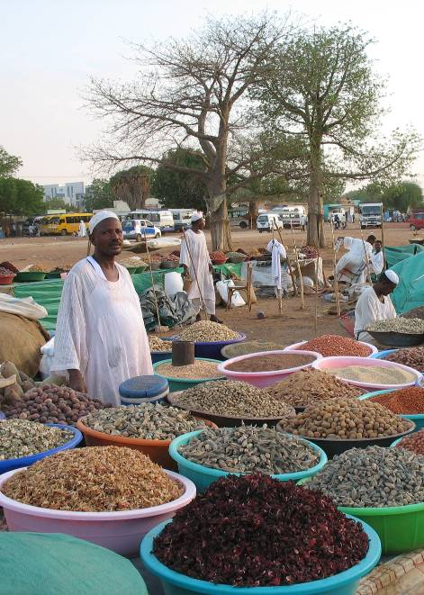
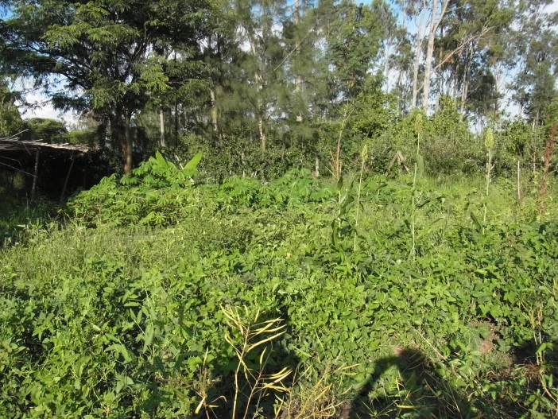
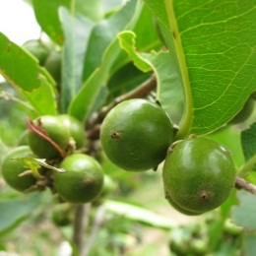
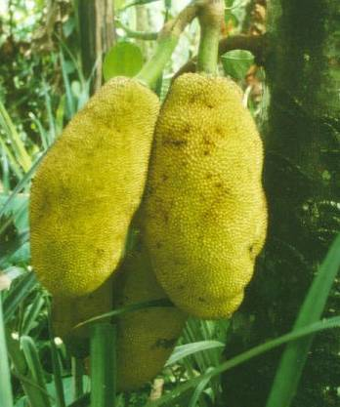
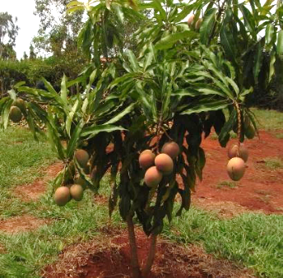
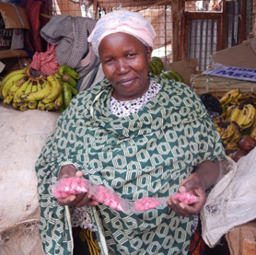
Agroforestry contributions to Reconciling Biodiversity and resource uses in Africa
PECS 2015 CONFERENCE
Social-ecological dynamics in the Anthropocene
5 November 2015, South Africa
Cheikh Mbow, ICRAF

Slide 2
Highlights
Diversification of agroecosystems enhance agrobiodiversity; ecological processes, biodiversity conservation and the delivery of ecosystem services
Agroforestry systems are complex systems where farmers have tended to integrate tree species in various productive niches or by managing biodiverse forest resources
Agroforestry can enhance the sustainability and resilience of agricultural systems by buffering climate change and maintaining diversity.
Difference in farming systems
Difference in purposes and planning
Difference in scales

Slide 3
What is the problem?
Current productive models
Inorganic fertilizers, pesticides, feed supplement
High yielding varieties, monoculture
Considerably increased production but the cost on natural capital yet to be evaluated
Ecological damage, degradation of soils, unsustainable use of resources; outbreak of pests and diseases
Unsustainable practices have resulted in lower yields,
Degraded or depleted natural resources agriculture’s encroachment into important natural ecological areas such as forests.
Increase yields without damaging biodiversity
There are many production systems in developing countries that respond to these requirements
That due to a lack of finance, resources, knowledge and capacity are well below the potential yield that could be achieved.

Slide 4
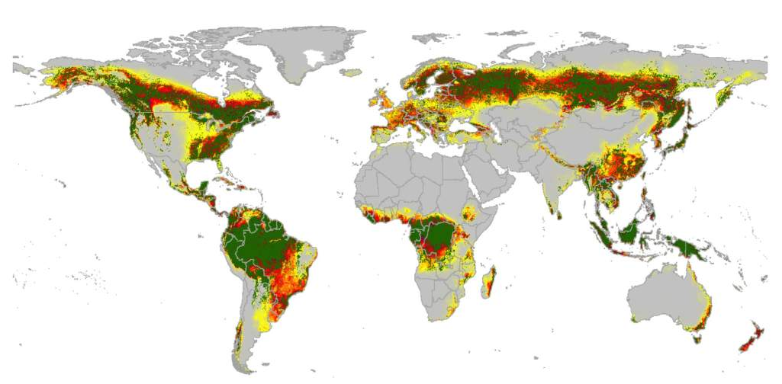
We estimate that 42-51% of global tree cover (24-34 Mio km²) has been lost historically – to make space for the dominantly agricultural landscapes
Ahrends, Xu et al. 2015, submitted to Nature Communication

Slide 5
Looking for the optimum
High
High extraction rate Low resources | High resources High extraction rate
Low extraction rate Low resources | Low extraction rate High resource
Extraction rate
Low
High
Resource/natural capital

Slide 6
The challenges of Biodiversity conservation through agroforestry
Managing biodiversity as a tradeoff for socioeconomic gains
How to limit damage while pursuing production
How to offset net loss while preserving resource used
Be high-yielding and sustainable
Biodiversity enhance the resilience of desirable ecosystem states/services.
Agroforestry to deliver multiple services—including yield—due to the combination of crops, trees and livestock

Slide 7
The role of AF for BES and resource use
About 90% of the biodiversity resources in the tropics are located in human-dominated working landscapes (Garrity, 2004).
‘On-farm conservation’ is considered to be a sustainable management of genetic diversity of locally developed traditional crop varieties with associated wild and weedy species.
Progress in domestication: is an opportunity for diversification and a resources benefit? (Germplasm collection, genetic parameters, propagation, conservation)

Slide 8
Maneuvering with many overlapping concepts
Land Equivalent Ratio: situations where intercropping has to be compared with growing each crop in pure stand.
Agroforestry: As a competitive advantage of growing trees with crops/livestock for livelihood and biodiversity conservation
Ecosystem management: As a way for maintaining ecological integrity
Land sharing/Sparing: As a way for managing biodiversity and optimize land use
Landscape management: As a way for managing multifunctionality
Landscape equilibriums
Maintaining viable populations (Biodiversity),
Ecosystem representation (Biodiversity, mosaic landscapes),
Maintaining ecological process (natural disturbance regimes, equilibriums),
Protecting evolutionary potential of species and ecosystems, and
Accommodating human use in light of the above.

Slide 9
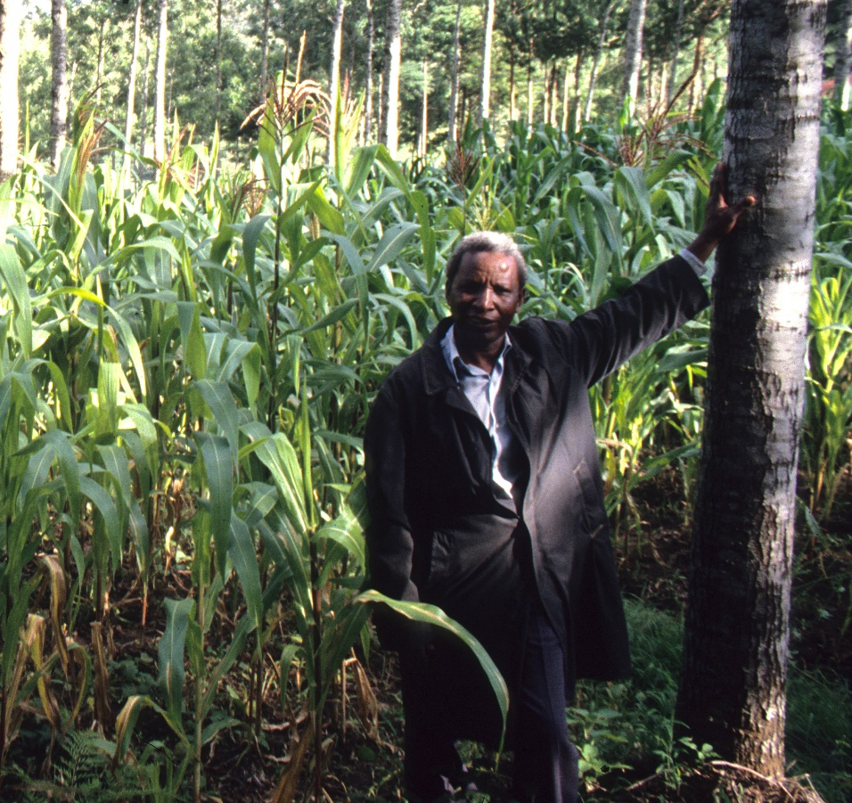
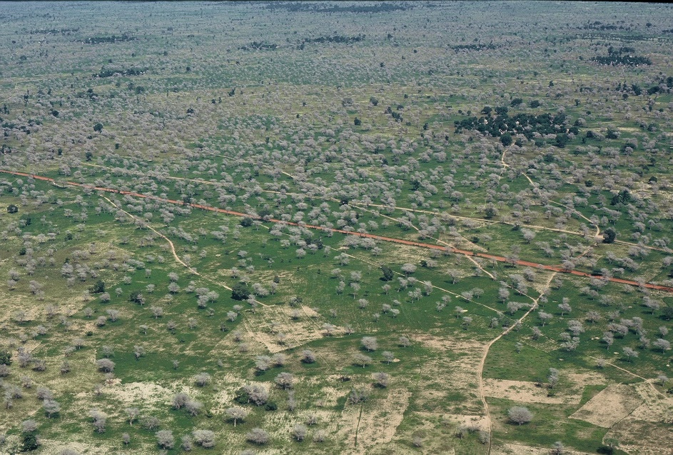
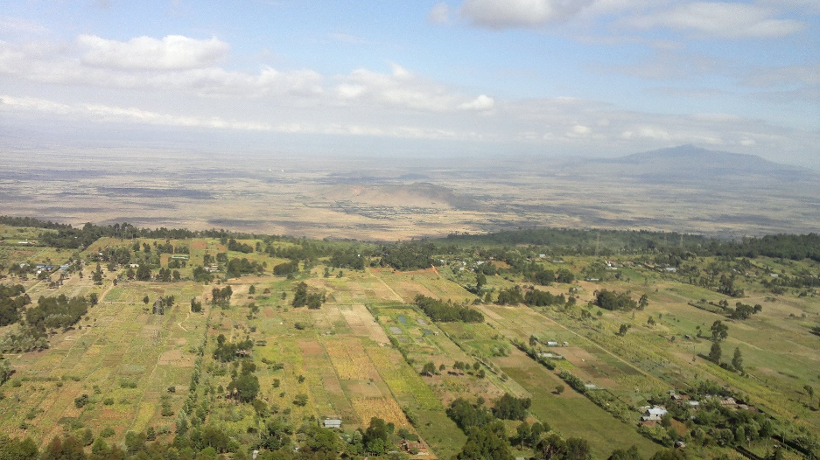
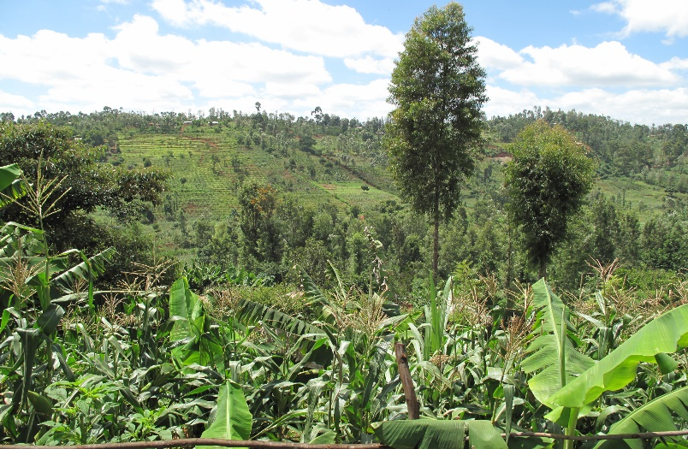
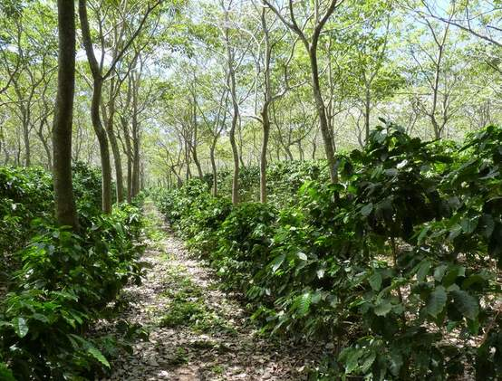
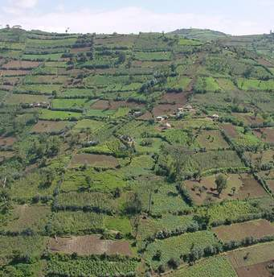
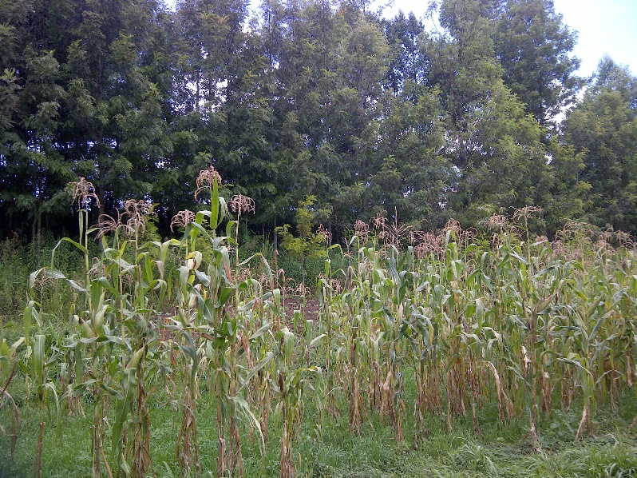
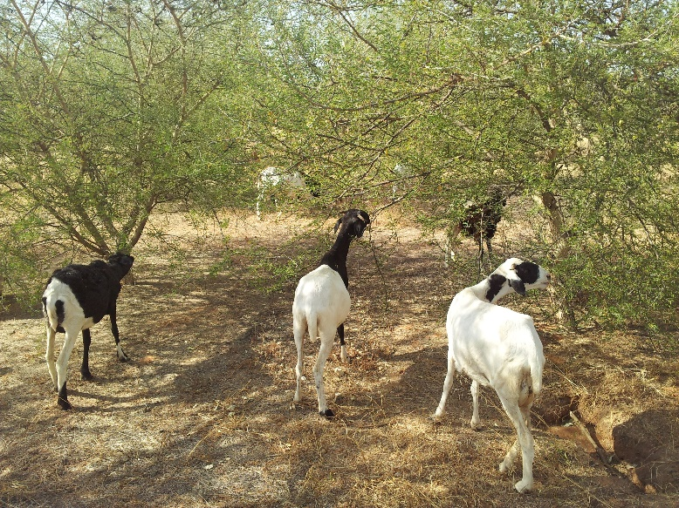

Slide 10
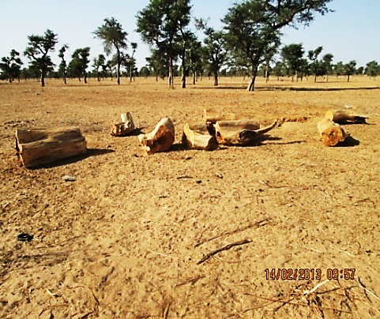
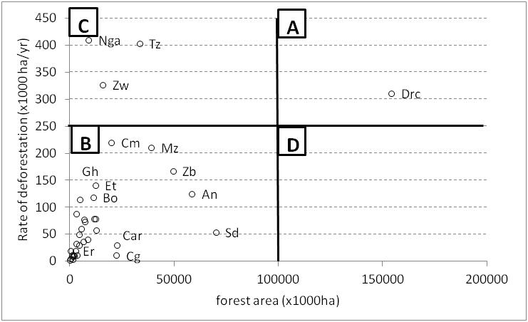
The potential for expanding agroforestry in Africa
Non “Forest” Ecosystems
Brink et al 2009
Mbow et al., 2012, GLP Report series (REDD= challenges and prospects for Africa)

Slide 11
Agricultural systems with trees
Typology of AF | Key elements | Examples AF practices
Ecological | Geographical location (AF system adaptability to particular ecologies) | Lowland humid or sub-humid tropics AF
Physiognomy | Parkland, Mosaic Multistoried homegarden | Faidherbia, Shea butter parks in West Africa Long term fallows
Compositional / structural | Simultaneous or sequential combination of Trees, crop, animal | Trees in pasture and rangelands (silvopastoral) and agriculture (agrosilvopastoral)
Practices (systems) | Management systems, livelihood | Hedgerows, long term fallows, alley cropping, improved fallow, alley cropping, multilayer tree cropping, woodlots
Functional | Erosion control, soil fertility | Wind breaks, shelterbelts, erosion control/soil conservation, scattered nitrogen fixing trees, boundary planting
Socioeconomic | Scale of production and level of technology, input and management (Commercial, subsistence AF) | Low input, high input agroforestry

Slide 12






Agroforestry Products
Fruits and
nuts
Fertilizer
Medicinal, gums, etc
Timber, fuelwood
Fodder
Nutrition and health
Allanblackia
Varieties of fruits
Soil health & food security
Livestock
Income,
Livelihood, Environmental Services
Calliandra
Faidherbia albida
Shade, energy
Combating diseases, industrial products
Prunus africana
Tectona grandis

Slide 13
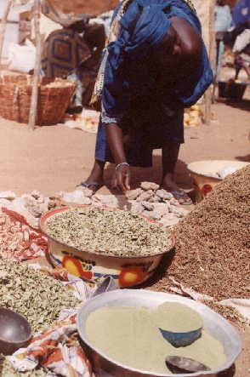
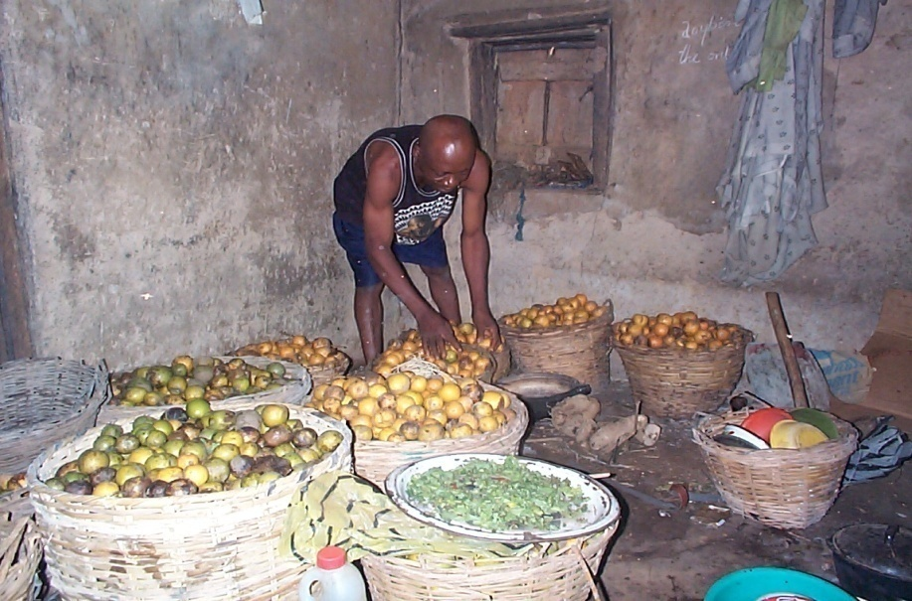
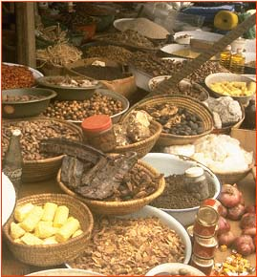
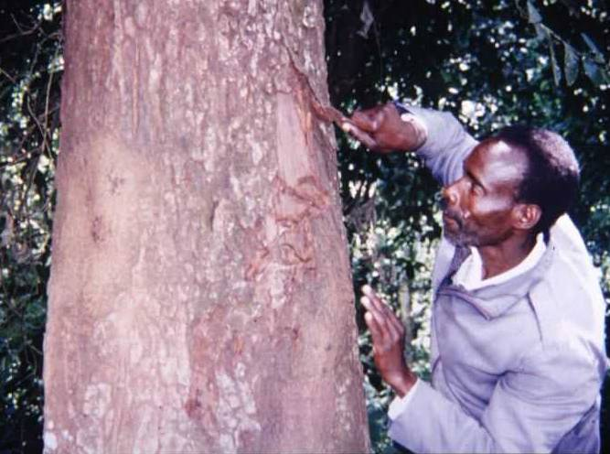
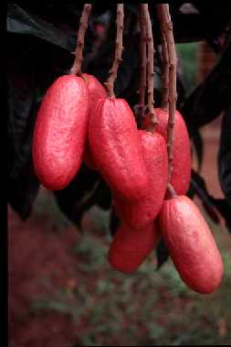
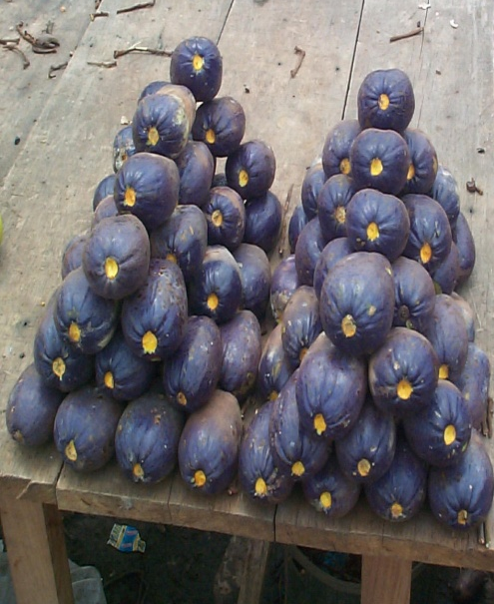
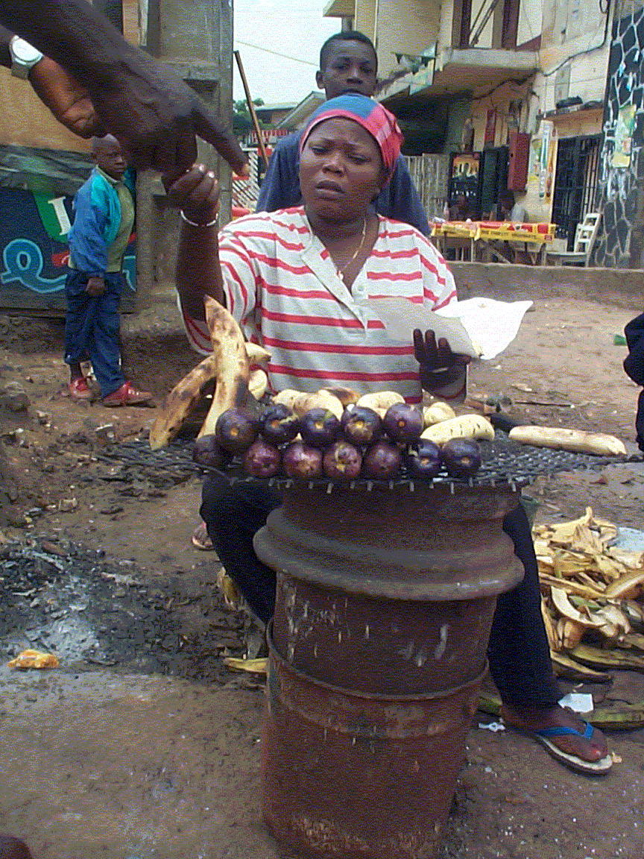
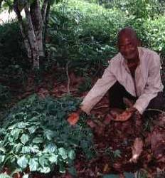
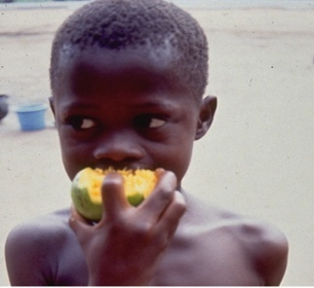
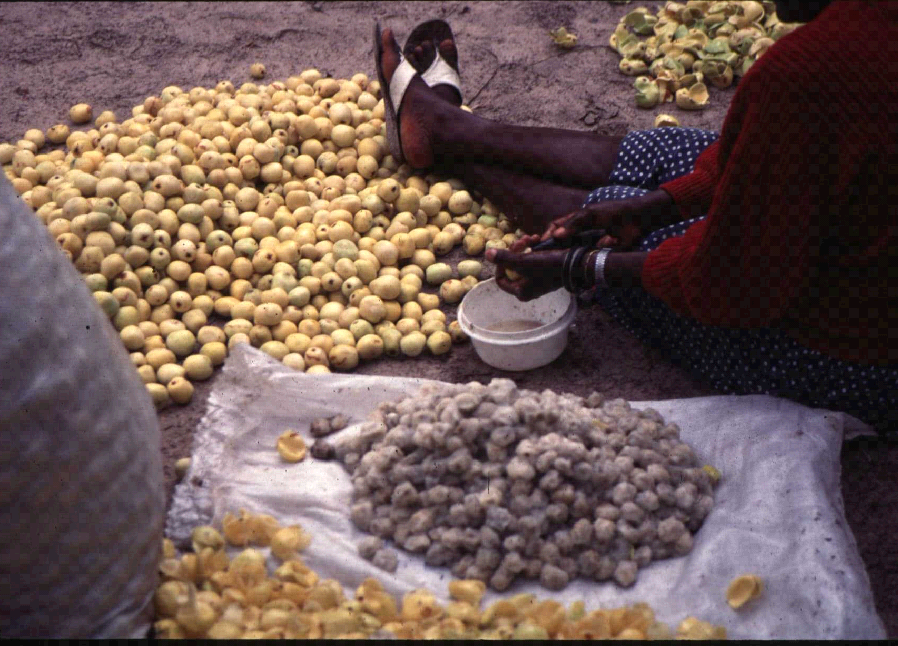
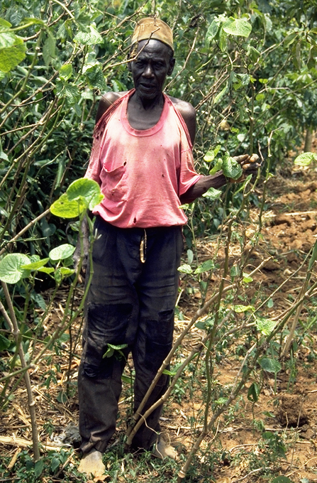
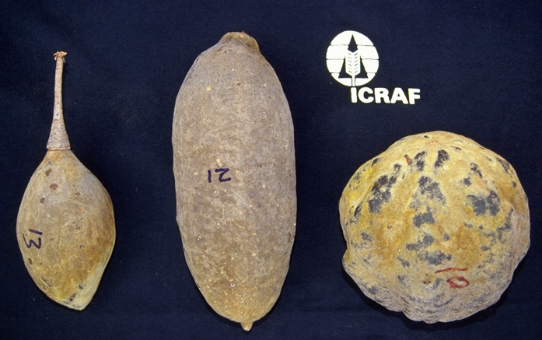
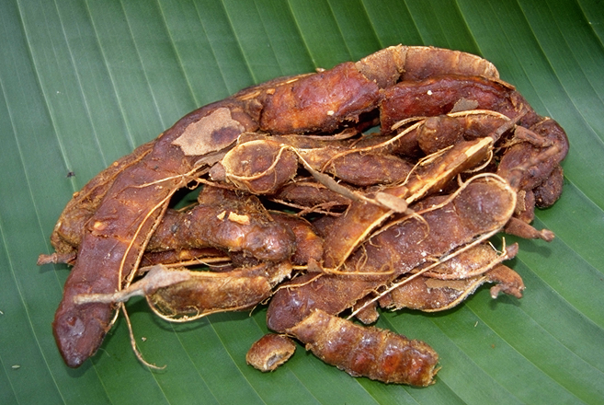
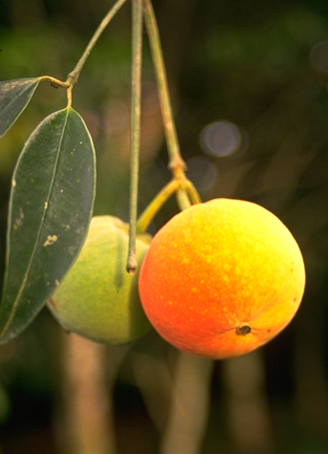

Slide 14
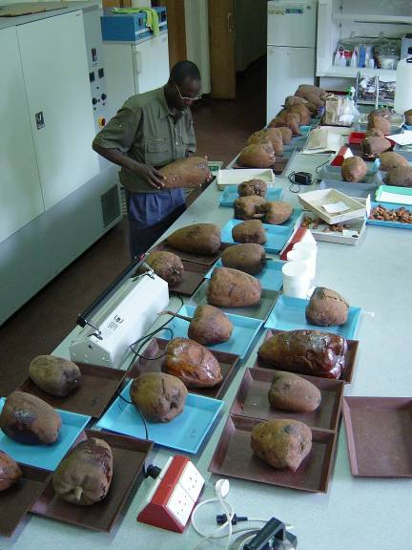
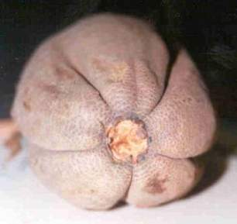
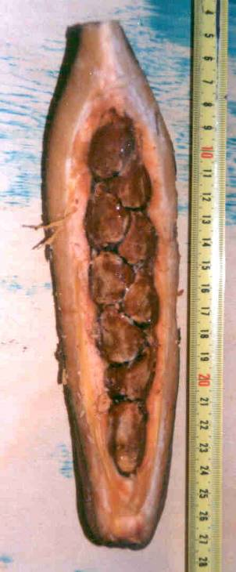
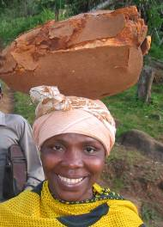
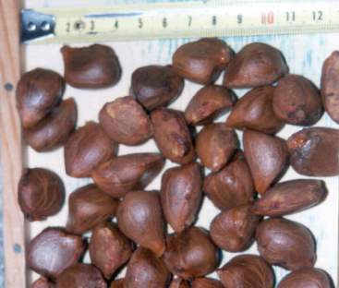
Market Potential of tree crops
Allanblackia floribunda

Slide 15
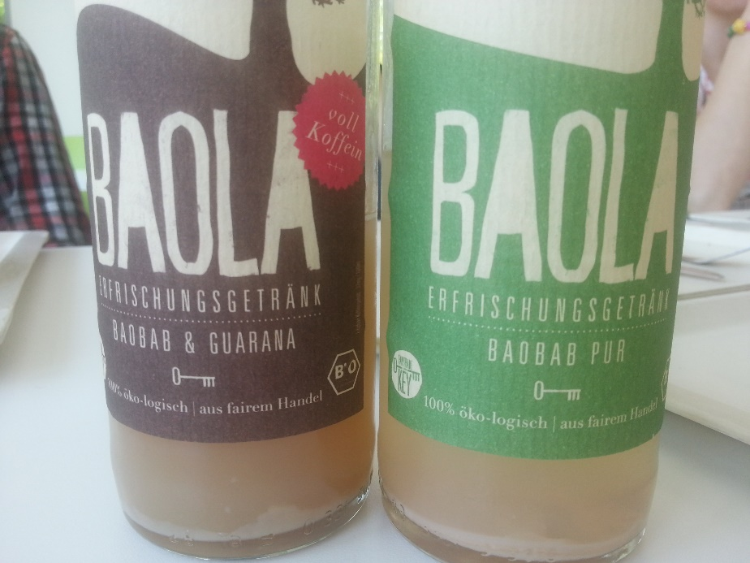
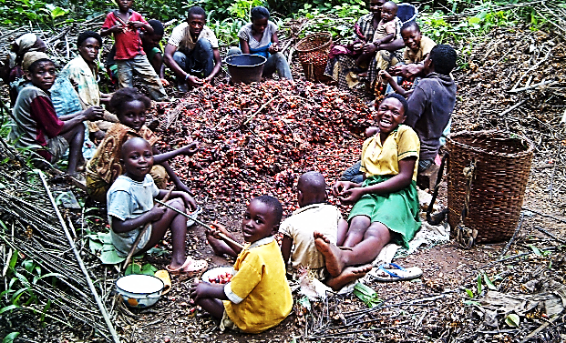
Income generation
How are trees used?
Food tree products often of high value (e.g. fruits, nuts, spices)
High potential for value addition through processing
Women often involved in collecting, processing and marketing food tree products

Slide 16
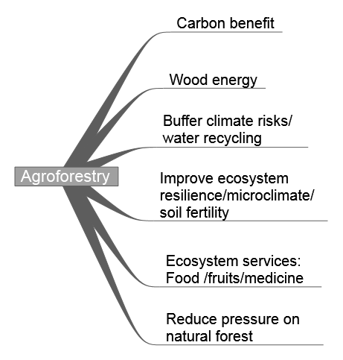
Synergies and tradeoffs bewteen mitigation and adaptation to CC
Livelihood
Mitigation | Adaptation
+++ | +
+++ | ++
++ | +++
+ | +++
- | +++
+++ | +
[Income]
[Asset]
[Asset]
tradeoffs mitigation-adaptation
[Asset-Income]
[Asset-Income]
[Asset-Income]
+++: very high positive impact; ++: high positive impact;
+: limited positive impact; -: zero positive or potential negative impact
Mbow et al, 2014-COSUST

Slide 17
Managing trade-offs
Bundling mitigation and adaptation benefits
Mbow et al, 2014-COSUST
Notes:
Secondly, there is a clear need to define conditions under which agroforstry can support the trade-offs between mitigation and adaptation and try to identify new frontier for safety nets that are beneficial to local vulnerable communities

Slide 18
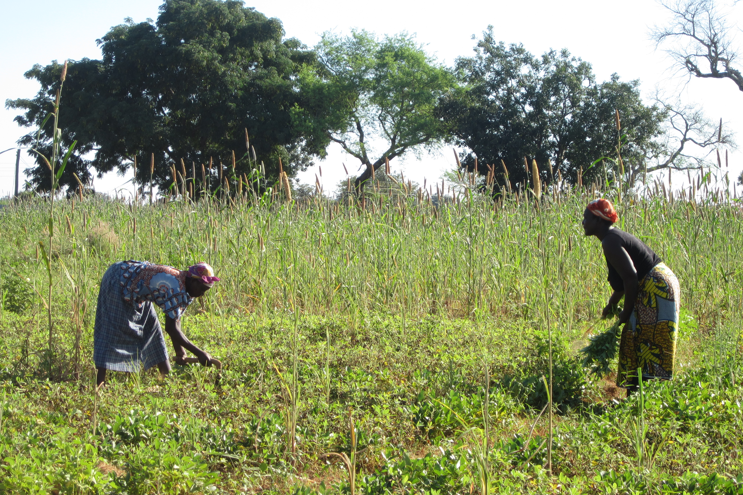
There is no “Silver bullet” or “one size fits all” in Agroforestry!
Agroforestry is not a single, specific agricultural technology or practice that can be universally applied.
It requires site-­specific assessments to identify suitable practices/land uses that aim to

Slide 19
Connecting ES to Agroforestry practices
Most studied topics is Ecological Economics-Valuation studies
Specific Agroforestry aspects come down on the list
  Sunita Chaudhary, Andrew McGregor, Donna Houston and Nakul Chettri, 2015 in Environmental Science Policy)
But biodiversity entry point give
more emphasis to agroforestry

Slide 20
Land suitability for developing Biodiv/ES based on AF practices
Land suitability | Examples of Land use | Implications for BES
Annual Crops | Mono-cropping of Millet/Maize | low
Perennials | Cocoa/Coffee | Low to medium
Perennials + Annual Crops | Fruit trees + Cassava | high
Grazing | Grassland | low
Grazing and Annual Crops | Mosaic crop/grasslands | Low to medium
Wood lots and crops | Islets of wood/ | Low to medium
Wood and grazing | Sylvopasture | Medium to high
Forest regeneration / fallows | Wood extraction/gathering | High to very high

Slide 21
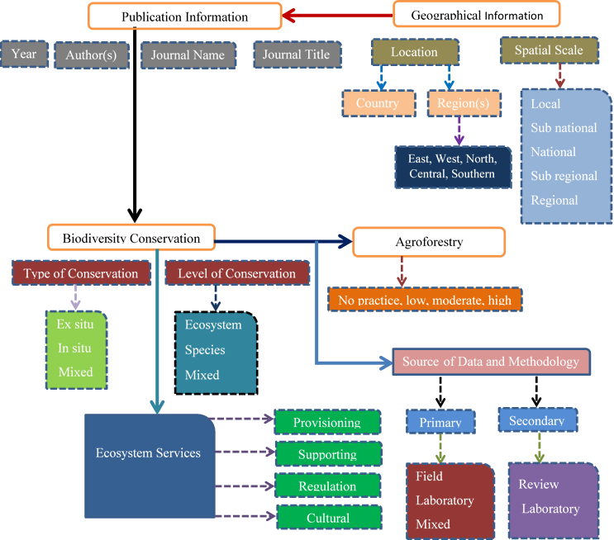
Synthesis of current literature

Slide 22
Improving Biodiversity and ES through Agroforestry
Maintain species richness/abundance, functionality
Maintain fluxes (Water, nutrient recycling, microclimate)
Prevent/control threats (fire, Erosion, pests)

Slide 23
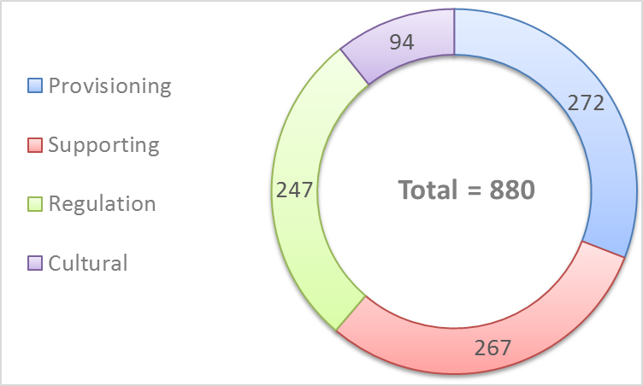
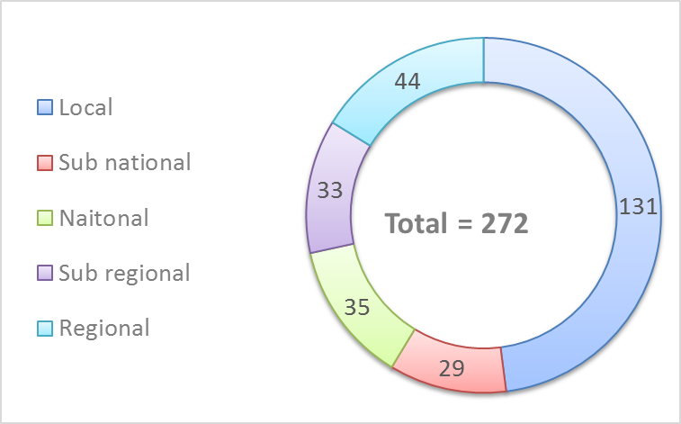
Ecosystem Services provided by Agroforestry
Scales of studies

Slide 24
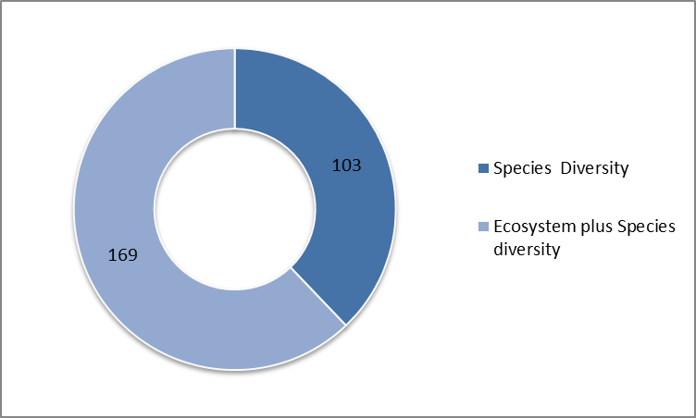
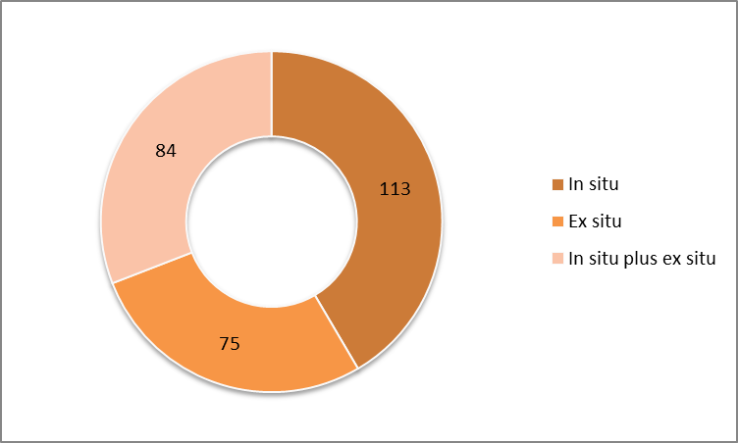
Level of Biodiversity Conservation
Biodiversity Conservation methods

Slide 25
Many research activities on the importance of agroforestry for conservation
Variation in Agroforestry Practices (total scientific papers = 272)
Agroforestry Practices (no) | No of Papers | Percent | Scale
0 | 49 | 18.08 | not practiced
1 | 60 | 22.06 | Low
2 | 56 | 20.59 | Moderate
3 | 107 | 39.34 | High

Slide 26
Repartition of studies in the continent

Slide 27
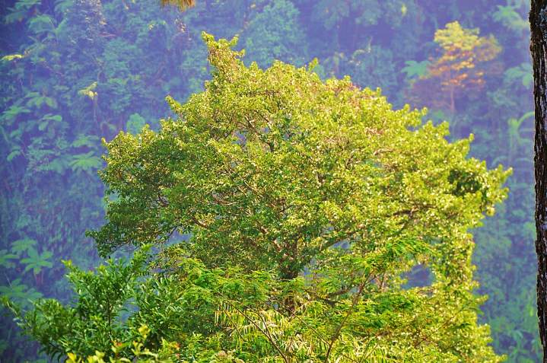
What approach to scale up agroforestry?

Slide 28
1. Actual agroforestry landscapes are a suboptimal member of the set of locally feasible landscape configurations to address socio-ecological resilience
2. Integrated approaches using agroforestry can nudge landscapes towards better managed tradeoffs of food-water-energy and climate
Mbow et al., 2015
Aims
Resilience;
Food Security
Implementation
Adaptive management; Negotiated changes; Skills;
Multiple stakeholders;
Participatory
Pre-requisites
Common concern;
Common entry point
Multifunctionality / Multiple scales

Slide 29
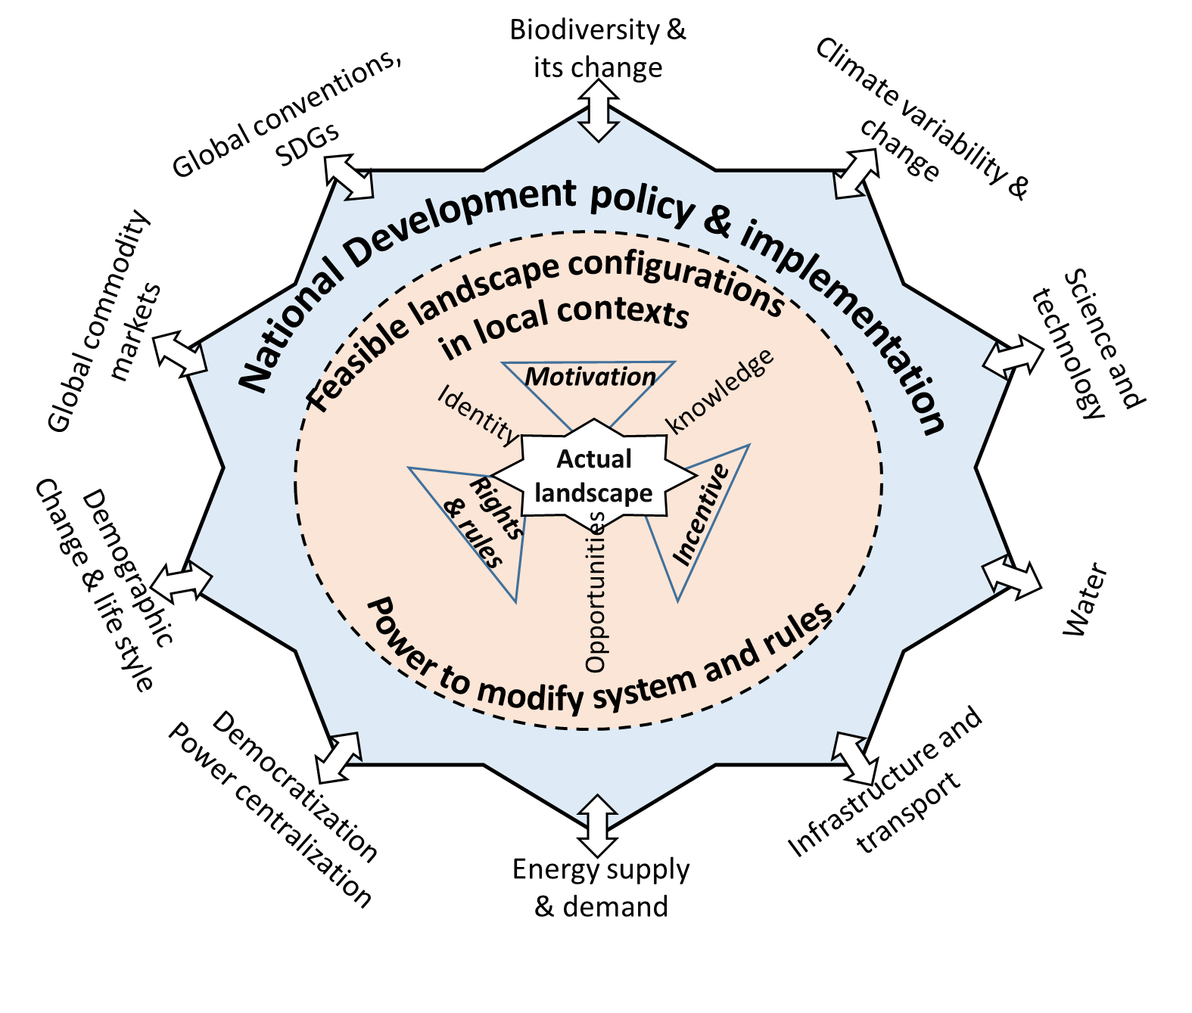
Level of complexity
CSL
Meet diverse stakeholder objectives,
Achieve multiple inter-related goals, often simultaneously
Framework to better integrate the social, economic and environmental dimensions
Noordwijk et al 2015

Slide 30
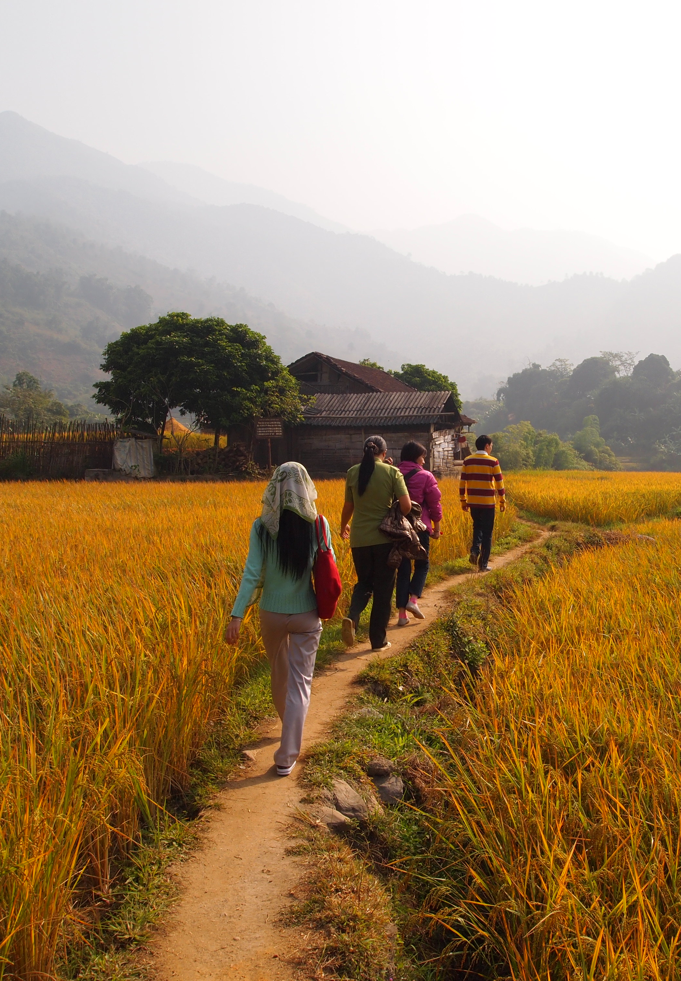
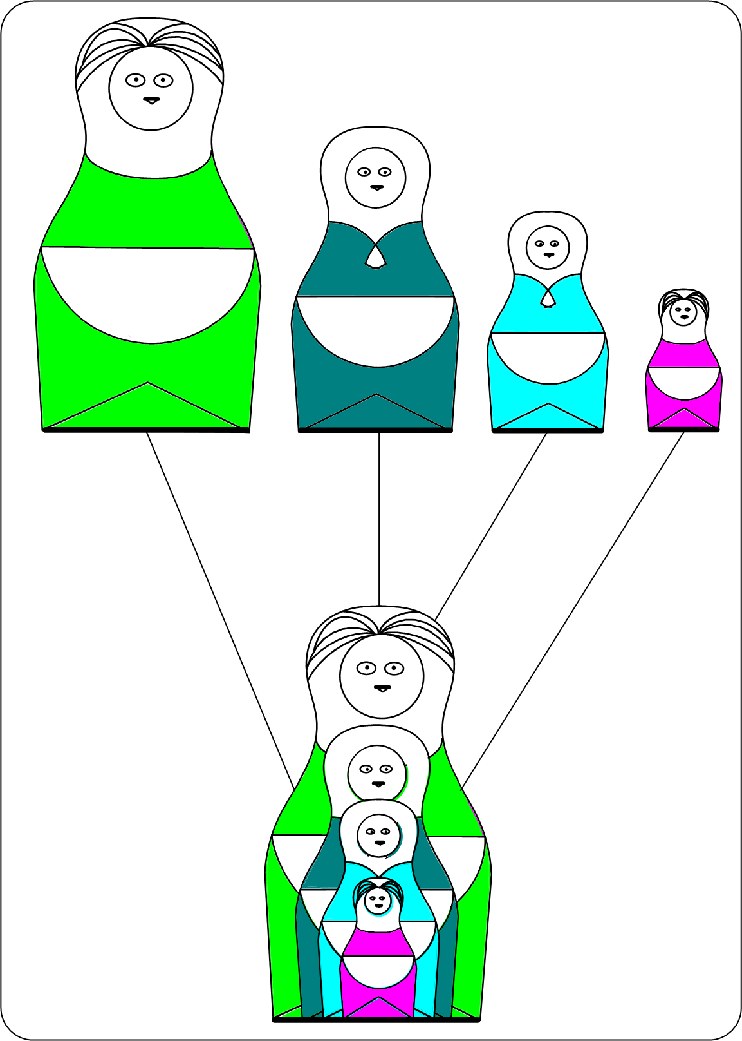
Scale issues
Scale Considerations
Transboundary, inferences,
actors, resources
Hierarchy in Scale
(The extent to which phenomena manifest differently at different scales)
Scale effect
(Changes in patterns and processes with change in scale)
Scaling
(Theories, methods, tools for translating / extrapolating across scales)
Nesting

Slide 31
Sample of uses: reasons for scaling up
Legume/staple food
Nitrogen fixing
Wood energy
Biodiversity
Edible-seeded/nuts
Oils/fats
Polyculture
Nutrition
Timber
Markets/income
Medicinal
Domestication
Multifunctional
Improved genomes
Nurseries

Slide 32
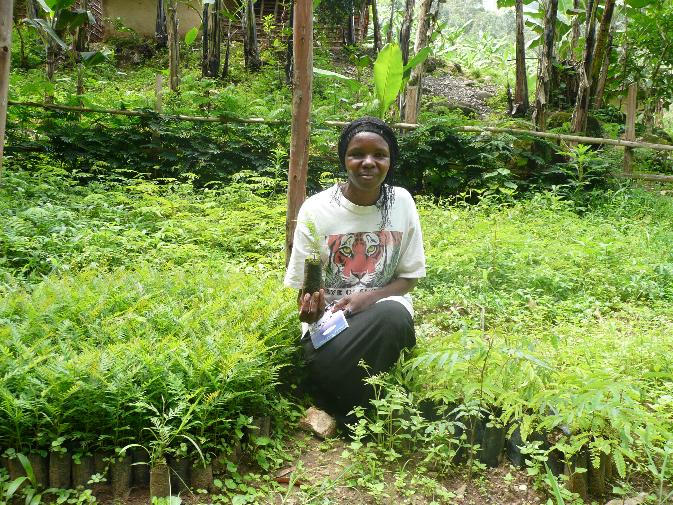
Four Propositions to conclude
Currently we are far from achieving multiple functions (sustainability) in landscapes;
However structured interactions, co-investments and negotiations among concerned actors can nudge farming systems towards multifunctionality;
Climate is one of many drivers of change in landscapes; market and institutions are also important
Agroforestry practices need to be grounded in local realities and linked to the ambitions or expected change of the people

Slide 33

c.mbow@cigar.org

