Slide 1
Ecosystem service tradeoffs and ecological-economic production possibilities frontier: A case study in Costa Rica
Vallet A.; Locatelli B.; Levrel H.
Notes:
There are many methods for analyzing tradeoffs between ecosystem services: how to use them? How do they compare? This is what I want to explore in this presentation.

Slide 2
How to analyze ES interactions?
Spatial correlations
Temporal correlations
Frontier curve
Envelope curves
ES2
ES2
ES2
ES2
(x₂,t₁)
(x₂,t₁)
(x₂,t₁)
(x₂,t₁)
(x₁,t₁)
(x₁,t₁)
(x₁,t₁)
(x₁,t₁)
(x₂,t₂)
(x₂,t₃)
(x₂,t₂)
(x₂,t₃)
(x₂,t₂)
(x₂,t₃)
(x₂,t₂)
(x₂,t₃)
(x₁,t₂)
(x₁,t₂)
(x₁,t₂)
(x₁,t₂)
(x₁,t₃)
(x₁,t₃)
(x₁,t₃)
(x₁,t₃)
(x,t)
(x,t)
ES1
ES1
ES1
ES1
Comparing pairs of value at different spatial units/time
Identifying Pareto-optimal configurations
Defining boundaries of possibility set
Different approaches can describe ecosystem services interactions differently
Notes:
Most common approaches to describe interactions are based on correlations, either spatial or temporal. They compare pairs of ecosystem services values at different spatial units or time.
Recently a new approach based on microeconomics and production theory had been applied to ecosystem services interactions. In this approach, the shape of the frontier curve, meaning the set of pareto-optimal configurations is used to describe the nature and intensity of tradeoffs.
But since by definition frontier curves only exist for tradeoffs, we propose to generalize them to envelope curves considering the boundaries of possibility sets. The two envelope curves describe the extremes levels of one ES achievable with a given level of the other ES
If spatial and temporal correlations remain on observed situations, frontier and envelope curves are based on scenarios to describe a broad range of possibilities.
And what we can see is that the nature (and the intensity) can be described differently in one approach or the other.
In the following of this presentation, we will exclusively focus on frontier and envelope curves approaches.

Slide 3
Application in Costa Rica
Modeling of 6 ecosystem services using InVEST (Sharp et al. 2014)
4 observed land-use maps in 1986, 1996, 2001 and 2008
32 contrasting land-use scenarios
Central Volcanic-Talamanca Biological Corridor
Notes:
Our application was conducted in Costa Rica, Central America, in a subpart of the Reventazon watershed that connect various protected areas.
We used InVEST software to model and map carbon sequestration, nitrogen, phosphorus and sediment retention as well as water yield. We also modeled agricultural production using statistical data on production yields and prices. So we modeled 6 ecosystem services in total.
We used various biophysical spatial data and coefficients to parameter InVESt models. Particularly, we used 4 land-uses maps produced for different time periods between 1986 and 2008 for the studied area. We also created 32 land-use scenarios considering slope and altitude constraints and assuming different LU proportions and distributions, either random or clustered.
And after running invest, we generated frontier and envelope curves for pairs of ecosystem services

Slide 4
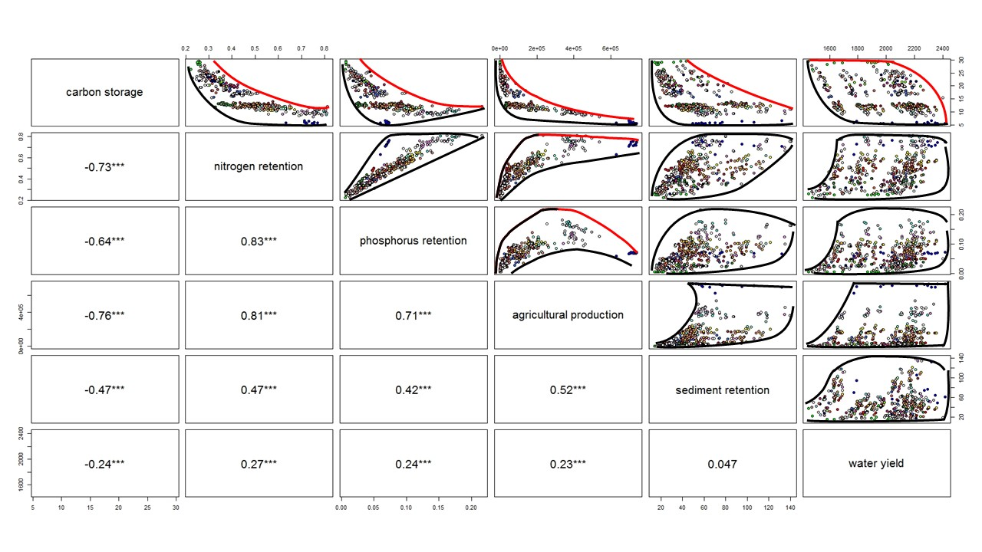
Frontier and envelope curves
Frontier curves exist only for tradeoffs (in red)
Threshold effects in moderate and non-monotonic tradeoffs
Frontier curves poorly reflect the range of possible ecosystem services levels
Envelope curves are more generalizable (in black)
Notes:
We observed 3 types of frontier curves (in red):
convex curves (for instance between C and pa) with intense tradeoff,
concave curves (like between C and wy) with moderate intensity,
and non-monotonic interactions, for instance in the case of phosphorus retention and agricultural production.
The two last examples, moderate and non-monotonic tradeoffs, are particularly interesting since they reveal threshold effects.
However, frontier curves cannot be drawn for most of pairs of ES because of their restrictive definition based on pareto-optimality.
In the case of synergies or non-interactive pairs of ES, only 1 scenario is optimal, the one identified as a red dot on these graphs.
Frontier curves, poorly reflect the range of possible ecosystem services levels in comparison of envelope curves.
They also have the advantage of being more generalizable since they can be drawn for all pairs without restriction.

Slide 5
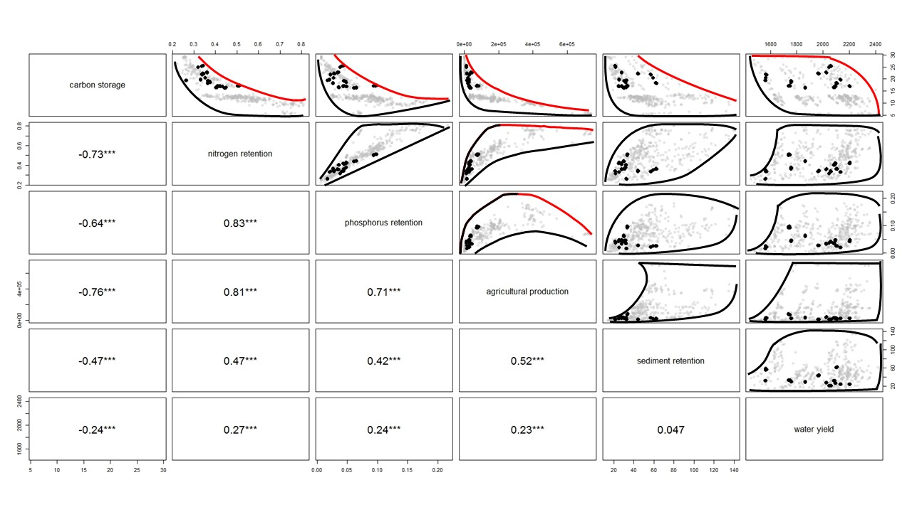
Position of observed land-uses
Observed situations → far from optimal
Not explained by rational optimization (social constraints)
Possibility sets include socially unacceptable situations
How to consider these constraints in the analysis?
Notes:
If we specifically look at the position of observed land-uses for the four time period between 1986 and 2008 I mentioned previously, we can observe that they are all in the least optimal configurations, for all pairs of ecosystem services.
This results highlight the fact that landscape configuration is not explained by rational optimization, but is shaped by the interaction of social constraints and actors preferences.
It also mean that in our set of scenarios, we included land-use configurations that are probably not acceptable for actors.
And this observation is crucial for next investigation because it rise the question of how considering these constrains and preferences in scenario analysis :
Should we add social constraints in the definition of scenarios?
Is it relevant to use non-acceptable LU configurations to describe ES interactions?
It also underline the necessity of better integrating socio-economical components in the assessment of ecosystem services, for two reasons:
First, To understand to which extend society choices influence LU configuration and could prevent from achieving optimal LU scenarios
And second to determine which solution on the frontier curve (when it exists) would be preferred by actors and ES beneficiaries.
Thank you for your attention, thanks Chairman for the invitation.

