Slide 1
Technology and social-ecological change: Scale mismatch, synergy and conflict in poor rural communities PECS CONFERENCE NOVEMBER 2015
Helene Ahlborg & Sverker Molander
Environmental Systems Analysis, Department of Energy and Environment
Chalmers University of Technology, Sweden
Notes:
Thank you. Title of speed talk.
I will tell you briefly about a discussion that is currently taking place among socio-technical scholars, on the value of theories developed around collective action and CPRs, most of you familiar with.
We want to make an argument which is both theoretical and based on empirical work by our group on renewable energy systems for electricity provision in African countries.

Slide 2
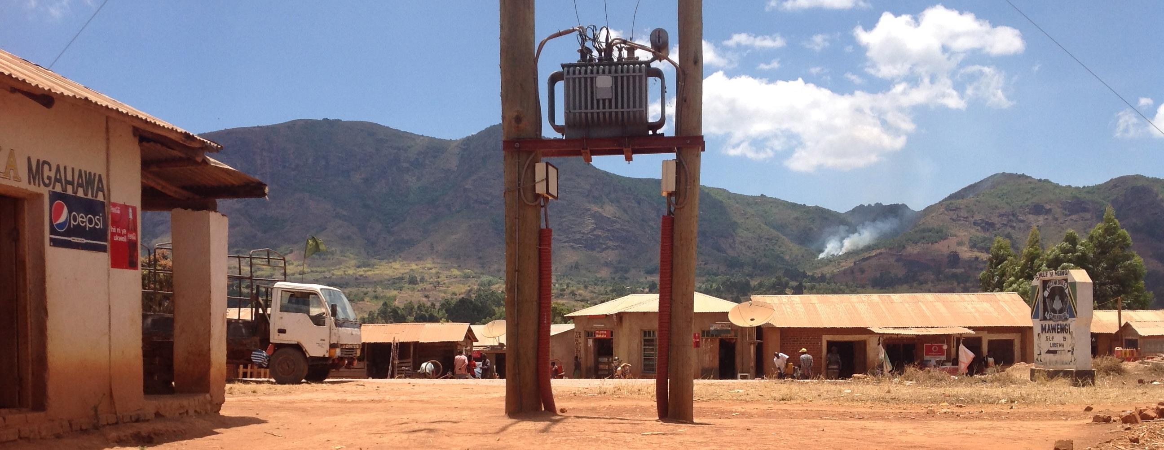
SOCIO-TECHNCIAL SYSTEMS
Characterized by complexity, uncertainty, multiple actors, multi-layered
Notes:
First, Socio-technical scholars understand systems in ways very similar to social-ecological scholars. share some key characteristics. There is a mutual basis to build from in how systems are understood.
We perceive technology and society as mutually constitutive and social-technical change as processes characterized by complexity, uncertainty, emergence and feedback loops.
Yet, there has not been much of a dialogue so far, despite both fields engaging with the urgent environmental and societal challenges of our time.
Recently, some socio-technical scholars have taken an interest in the literature on CPRs and collective action.

Slide 3
Socio-technical scholars propose
Wolsink (2012): “ The baseline is that microgrids (…) should be considered as common property”
“The options for achieving optimal use of renewable energy (…) can be viewed as a governance issue related to sustainable management of a CPR”
Small-scale electric grids are said to be rivalrous and non-excludable, hence CPR theory can help explain success and failure
In our view, this statement needs to be modified
Notes:
Some scholars, such as Wolsink, has proposed that small-scale isolated electric grids, e.g small-scale hydropower, should be conceptualized as common pool resources.
We work with such small-scale, renewable energy based, isolated grids in East Africa. It is assumed that these have the character of CPRs – that as a resource they are rivalrous and non-excludable
Is this a correct characterization of micro-grids? At a first glance, the statement seems correct, but we argue that when one looks more closely, and scrutinizes the claims, they do not hold. The similarity lies at the surface.

Slide 4
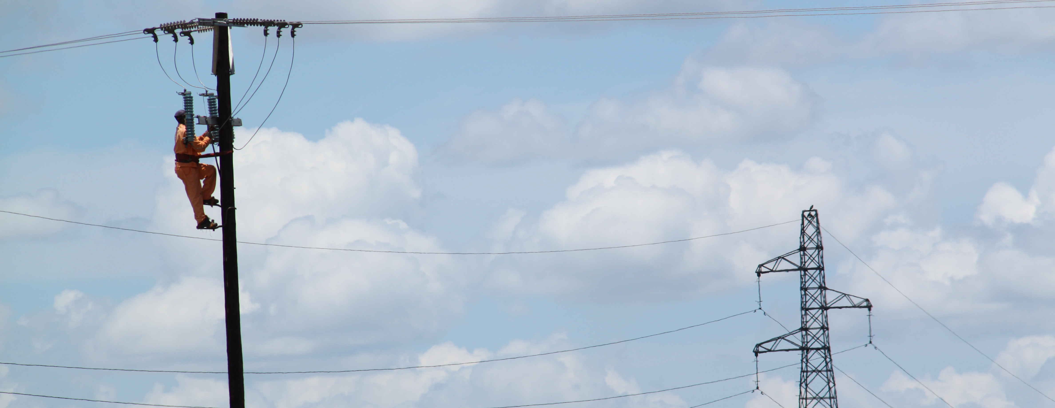
In well-functioning micro-grids, access and use is regulated
Poorly functioning grids can develop CPR-like dynamics – as negative outcome due to a combination of factors
Notes:
Based on our empirical studies of multiple small grids: we see that access to such grids is usually not difficult to control. One has to draw very peculiar system boundaries to regard them as non-excludable. Electricity theft is a problem, but much more so in large-scale national grids, than in small and locally operated grids.
Electricity units are rivalrous, but not in the same sense as e.g. water in an irrigation system. There are technical limitations to overuse, and technical control of individual users. Also, users often pay per unit and increased consumption results in higher income for the utility. For these reasons, and various other details I cannot mention now, the dynamics related to scarcity and balancing supply and demand are quite different from CPRs such as fisheries or irrigation systems.
However, when grids are managed badly, when institutional frameworks, operation and payment are not well organized, the system can acquire problems with free-riding and overuse (rather, under-capacity) over time. CPR dynamics are thus NOT INHERENT in the resource system, but may develop as a result of negative feedbacks. Then, specific in time and place, there may be partial CPR traits.

Slide 5
Socio-technical systems ←→ CPRs
Results in scale mismatch, conflict of interest, potential synergies
A new dynamic develops: socio-technical-ecological systems
Notes:
So what are then micro-grids if they are not CPRs?
Micro-grids are man made structures that embody the intention of designers. The system configuration is always material and institutional. It regulates user behaviour through its particular configuration and is reshaped in the process.
Electricity systems interplay with social-ecological systems – for example, in small-scale hydropower in Tanzania, there can be CPR dynamic around the river that supplies the hydropower plant. This creates an interesting and complex interface. Electrification processes become drivers for change in land use practices, creates new institutional layers and new interests
. We have seen it create scale mismatch and conflict. The social-ecological dynamics change character due to the technology, the technology presents new opportunities.
It is a political process, and it cannot be characterized as CPR or as sociotechnical. We believe that existing frameworks are not good enough. We hope for continued dialogue, that engages in depth with understanding the socio-technical-ecological dynamics of electricity systems and other infrastructures.
Thank you.

