Slide 1

Seeds of good Anthropocenes
GAME SESSION
Joost Vervoort, Garry Peterson, Tanja Hichert, Steve Carpenter, Per Olsson, My Sellberg, Uno Svedin, Owen Gaffney, Oonsie Biggs, Elena Bennett, Hanna Wetterstrand, Albert Norström, Kim Nicholas

Slide 2
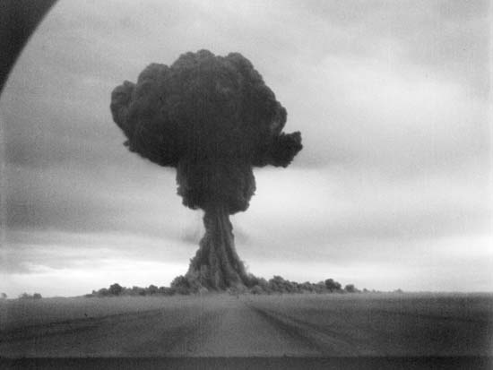
The Anthropocene
1945: Bye bye, sweet Holocene!
‘Human activity detectably affects the functioning of the earth system and pushes it beyond the boundaries of its natural variability’
(Steffen, Hamilton and others)
Humans as geological force – from influencing to dominating

Slide 3
Thinking Anthropocenes
A fundamental change in the relationship between humans and the earth system - A fundamental change in what it means to be human!
What scenarios?
Traps:
  Downplaying and ignoring
  Wishful thinking; ‘eco-modernist techno-optimism’
  Fatalism
  Hard to imagine other scenarios
  Multiple ‘good anthropocenes’ from different perspectives

Slide 4
Seeds of good Anthropocenes
  Avoiding traps by focusing on pockets of transformative futures in the face of Anthropocene challenges
  ‘Seed’ initiatives with the potential for global impact in the face of the Anthropocene (transition towns; robin hood hedge funds; new energy initiatives..) – new ways of doing, thinking, institutions, technology
  Not mainstream, at the margins
  Must already exist, at least partially or in prototype
  In the face of Anthropocene challenges

Slide 5
Why a game?
Combine seeds; combining seeds with Anthropocenes; potential – randomness → imagining truly new scenarios
Experiential futures through role playing
Empowerment/creativity, ‘gameful’ attitude in the face of change; self-efficacy
For seed initiatives; Future Earth researchers + students
Link to database!
Different versions: board game; workshop format; on-line – development with Utrecht games lab; GCU games lab; Transmango; students and conferences

Slide 6
Game steps
Dividing roles: seeds, Anthropocene, social context; roles
Filling in character sheets; setting the scene
Creating coalitions and ideas
Evaluating ideas
Results and discussing the scenario
Feedback on the process

Slide 7
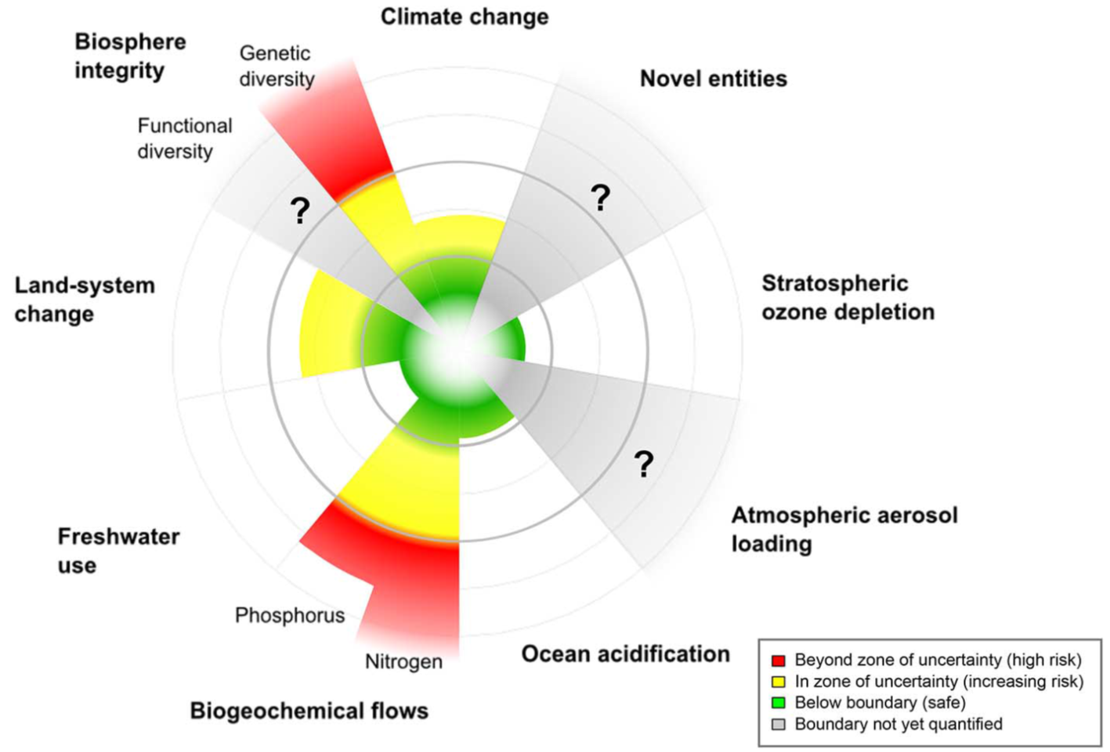
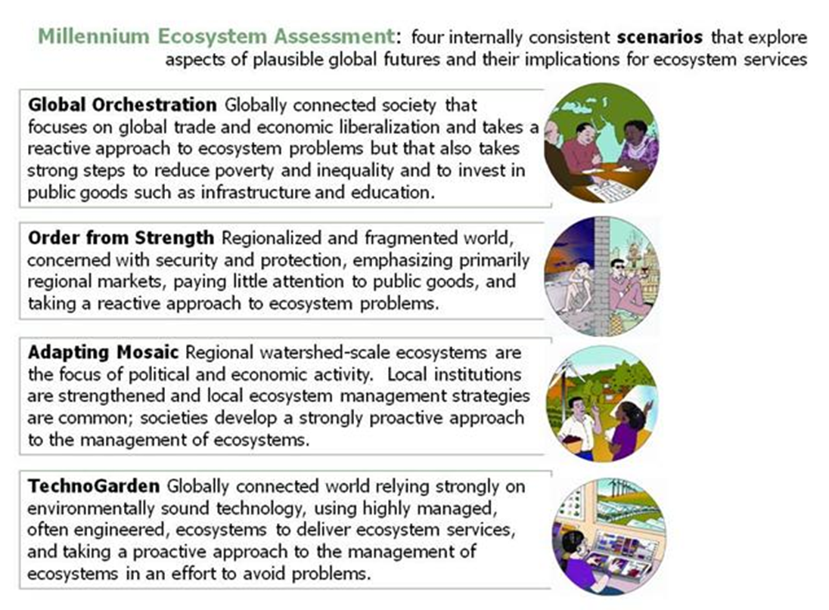
Phase 1: Seeds + setting the scenario scene
Realistic role playing
Players of seed initiatives make character sheets (discuss in pairs)
Anthropocene
players make scenario + characters
Link scenarios
Players start forming coalitions
Social scenario players make scenario + characters, groups?
Supplementary seeds
TIME: 20 MINUTES PREP; 10 MINUTES COMMUNICATION;
10 MINUTES PRESENTATION

Slide 8
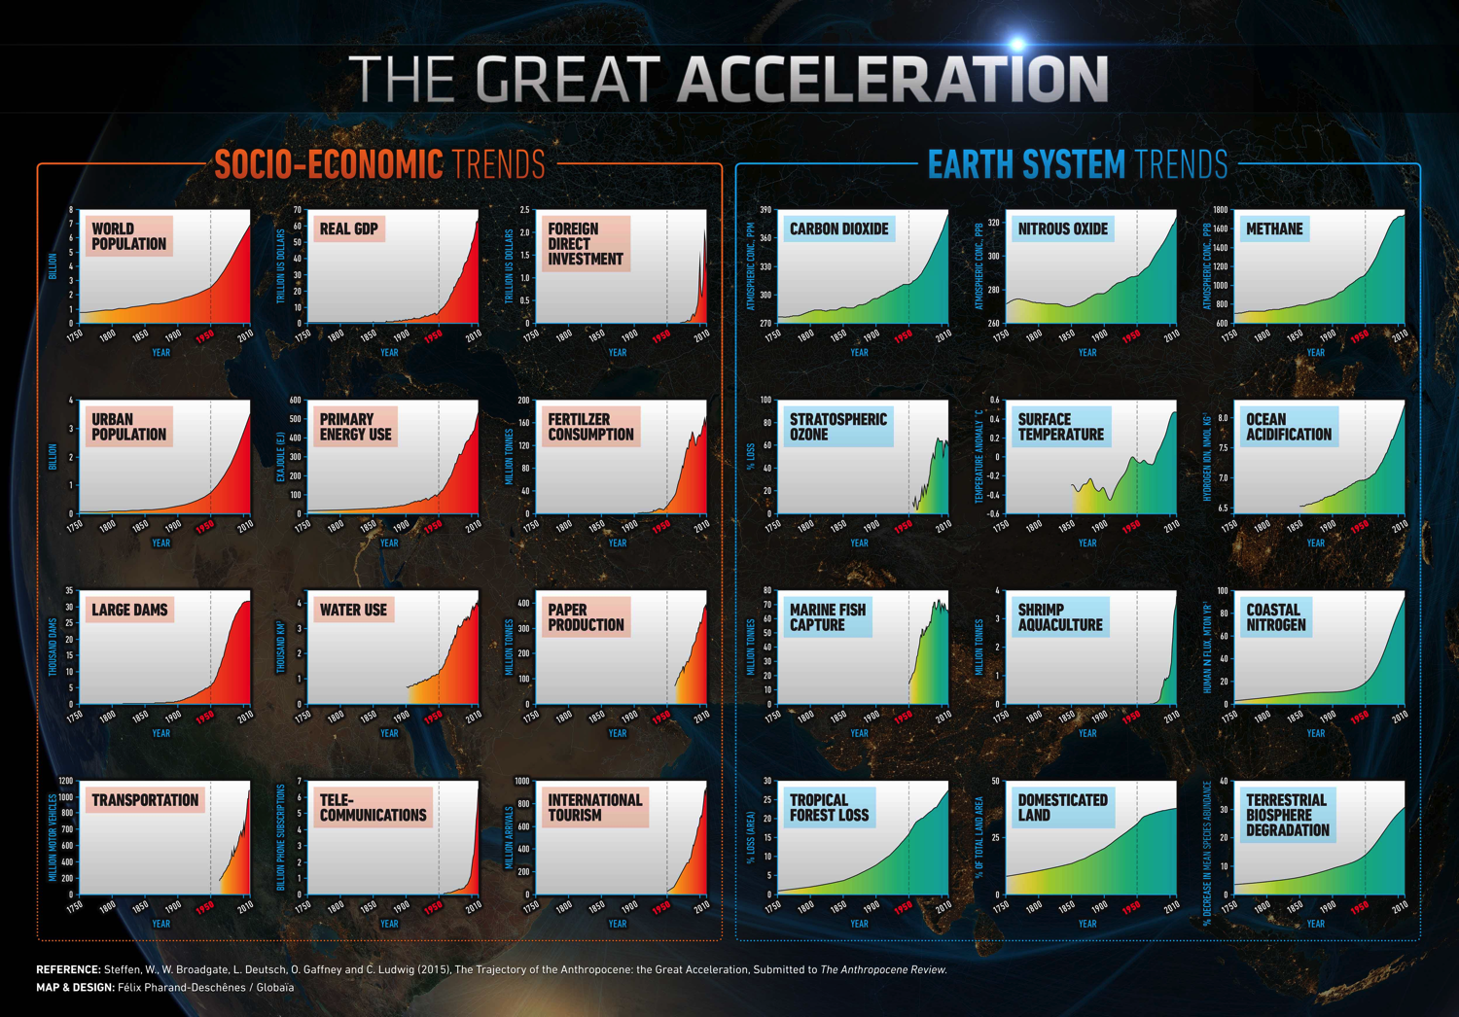

Slide 9
‘Planetary boundaries’
Steffen et al. 2015

Slide 10
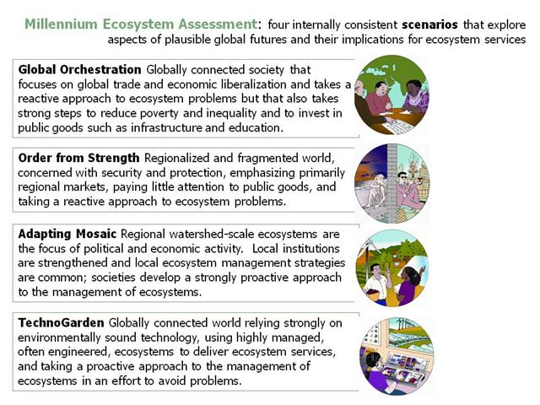

Slide 11
Players of seed initiatives scramble to create coalitions to develop combined ideas – what can be done in 20 years?
Phase 2: Coalitions
(Representatives of the social scenario and of the Anthropocene challenges can be coaxed to help coalitions think; or fill in new seeds)
Flip-charts:
Presenting ideas to fit (or go against) context
TIME: 20 MINUTES
Single seed proposals allowed (but not preferred)

Slide 12
Phase 3: Presentation of seeds - evaluation of feasibility
Anthropocene
Scenario second:
0 to 10 rating
Link scenarios
Social scenario
First: 0 to 10
rating
TIME: 25 minutes presentation and evaluation

Slide 13

Phase 3: Presentation of seeds - evaluation of feasibility
Anthropocene
Scenario second:
0 to 10 rating
Link scenarios
Social acceptability (0-10) + expected impact (0-10);
Social scenario
First: 0 to 10
rating
TIME: 5 minutes for results and 30 scenario imagining; 10 minutes for reflection on process

Slide 14
From games to the database and project
Feed individual rounds back to the database (Utrecht app)
Let seed initiatives know how people are thinking about their seeds
Able to aggregate seed combinations
Create macro-scenarios out of game building blocks!

Slide 15
Thank you!
Steffen, W. e. a. 20015. Planetary boundaries: Guiding human development on a changing planet. Science 347.
Vervoort, J. M., D. H. Keuskamp, K. Kok, R. van Lammeren, T. Stolk, T. Veldkamp, J. Rekveld, R. Schelfhout, B. Teklenburg, A. Cavalheiro Borges, Jáno, S. kóva, W. Wits, N. Assmann, E. Abdi Dezfouli, K. Cunningham, B. Nordeman, and H. Rowlands. 2014a. A sense of change: media designers and artists communicating about complexity in social-ecological systems. Ecology and Society 19.
Vervoort, J. M., K. Kok, P. J. Beers, R. Van Lammeren, and R. Janssen. 2012. Combining analytic and experiential communication in participatory scenario development. Landscape and Urban Planning 107:203-213.
Vervoort, J. M., K. Kok, R. van Lammeren, and T. Veldkamp. 2010. Stepping into futures: Exploring the potential of interactive media for participatory scenarios on social-ecological systems. Futures 42:604-616.
Vervoort, J. M., P. K. Thornton, P. Kristjanson, W. Förch, P. J. Ericksen, K. Kok, J. S. I. Ingram, M. Herrero, A. Palazzo, A. E. S. Helfgott, A. Wilkinson, P. Havlík, D. Mason-D'Croz, and C. Jost. 2014b. Challenges to scenario-guided adaptive action on food security under climate change. Global Environmental Change.
Good-anthropocenes.org
Joost.vervoort@eci.ox.ac.uk

