Slide 1


Land use-based approach to the assessment of ecosystem services in participatory coastal management
Leena Karrasch
COAST – Centre for Environmental and Sustainability Research
Carl von Ossietzky University Oldenburg, Germany

Slide 2
Introduction
Land use planning and management in coastal regions is affected by ecological and anthropogenic changes.
To foster an ecosystem-based management, the ecosystem services approach is a decisive concept.
Nevertheless, the incorporation of ecosystem services in management processes often lacks the understanding of regional stakeholders.
And, the relationships between landscape and the provision of ecosystem services is not well analysed.

Slide 3
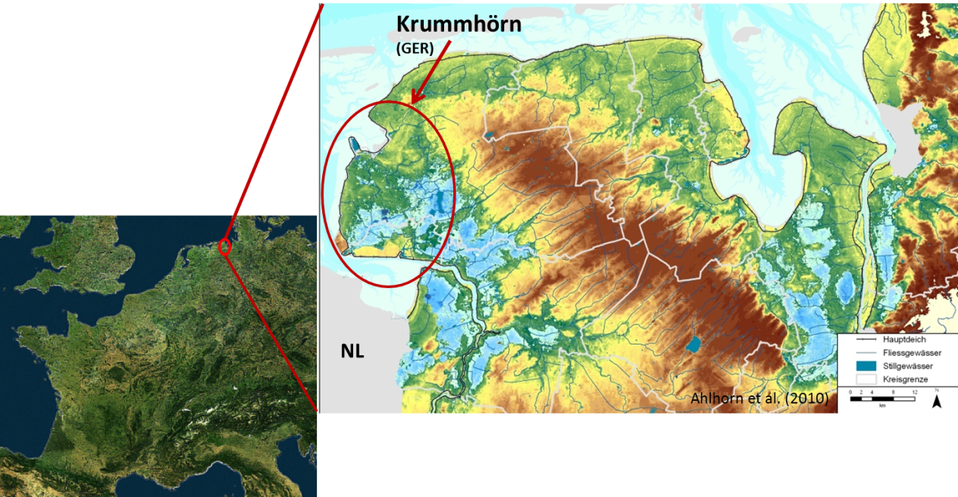
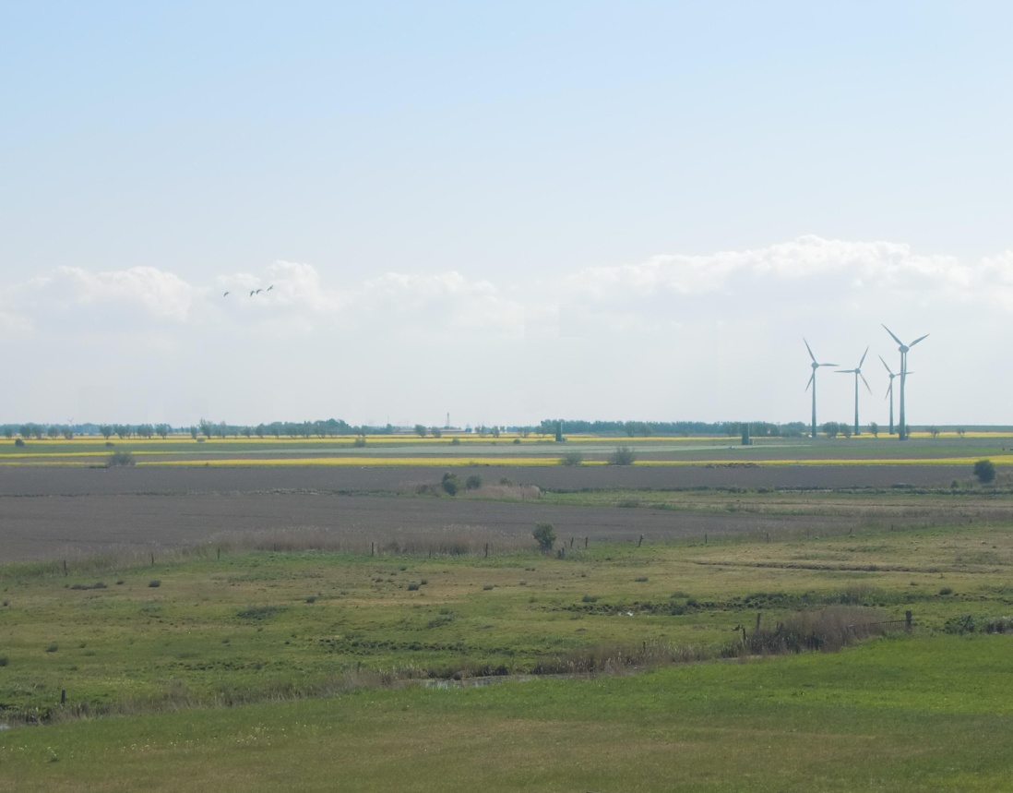
Case study area
A land used-based approach to ecosystem services assessment:
Can ecosystem services be projected on a regional level across a north-west European landscape by using land use elements as indicators?
Is a qualitative survey of the potential of regional land use elements to provide ecosystem services capable to support regional coastal management?

Slide 4
Methodological approach
Participatory process (interviews and written assessment)
Aim: to evaluate the land use elements´ capacity to provide ecosystem services
12 local and regional decision-makers (agriculture, nature conservation, water management, policy, tourism)
Contextualize land use elements and ecosystem services
Examine and define ecosystem services
Examine and define land use elements

Slide 5
Data analysis
To analyse how the sector representatives perceive the relevance and grade the relationships between land use elements and ecosystem services, three measures were used:
  Simpson´s Index (probability that two grades from the stakeholder´s rating tables belong to the same relevance rating)
  Variance (dispersion of grading)
  Median (determines location of agreements)
The combination allows to cluster the results concerning the relevance of land use elements-ecosystem services attributions: Agreements, disagreements and contrary opinions.

Slide 6
Results
The sector representatives defined 19 regional specific land use elements and 18 regional specific ecosystem services.
They successfully managed to determine the relationships of 342 possible land use element-ecosystem services attributions:
32.5 % agreements, 65 % disagreements and 2.5 % contrary opinions concerning the relevance.

Slide 7
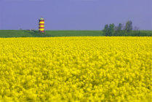
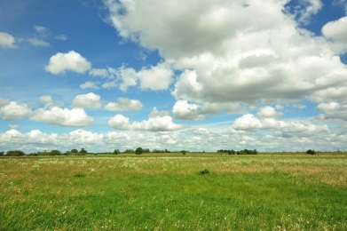
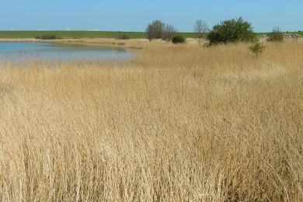
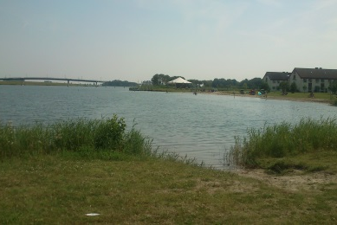
Results
Monofunctional attributions:
trivial linkages
Fields for bioenergy
Energy
Extensively used wetlands
Biodiversity
Reed stands in polder areas
Carbon sequestration
Polder areas
Fresh water retention

Slide 8
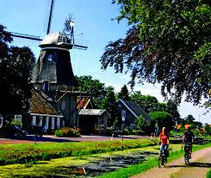
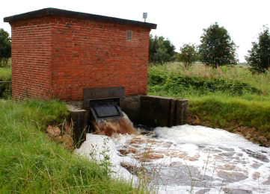
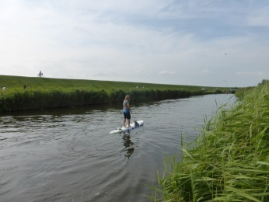
Results
Bundles of ecosystem services:
to fullfill diverse societal, ecological and economic demands
Buildings
Recreation, tourism
Infrastructure
Feeling of safety
Rapid water drainage
Freshwater retention
Rivers, creeks and ditches
Recreation, tourism
Biodiversity
Soil fertility

Slide 9
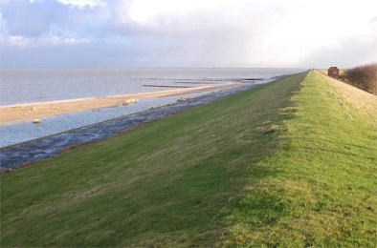
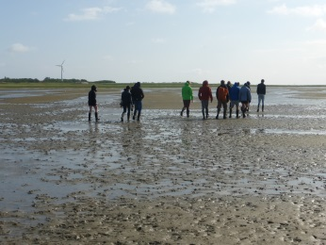
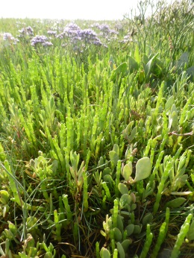
Results
Bundles of ecosystem services:
to fullfill diverse societal, ecological and economic
demands
Saltwater retention
Sedimentation
Mud flats
Community identification and connection
Recreation, tourism
Biodiversity
Livestock
Prevention of saltwater intrusion
Dike
Wave attenuation
Salt marshes
Community identification and connection
Recreation, tourism
Feeling of safety

Slide 10
Results
Contrary opinions:
(i) Protection-function of the dike vs. considering the dike itself
(ii) Different perceptions
Dikes
Water supply
Reed stands in polder areas
Community identification and connection
Grassland
Erosion control

Slide 11
Results
Disagreements:
The main reason is the different background and therefore different understanding / demands of the stakeholders.
Livestock
Buildings
Energy
Water supply
Agricultural land use
Biodiversity
Farmer: yes
Nature conservationists: no
Other: medium

Slide 12
Results
Trade-offs:
1) Between different ecosystem services
Crops
Arable fields
Livestock
Meadows and pastures
Intensification leads to decrease
Necessary for
Soil fertility

Slide 13
Results
Trade-offs:
2) Due to spatial mismatches:
Extensively used wetlands
Biodiversity
Reed stands in polder areas
Carbon sequestration
Increase leads to decrease
Arable fields
Crops
Meadows and pastures
Livestock

Slide 14
Conclusion
The applied methodology provides a practical option to bring a landscape with its land use elements into contact with the concept of ecosystem services in stakeholder-driven land use planning.
The results made it possible to:
(i) Attribute ecosystem services to land use elements as considered in the regional socio-ecological land use management regime
(ii) Foster the implementation of an ecosystem-based management by including ecosystem services in decision-making processes.

Slide 15
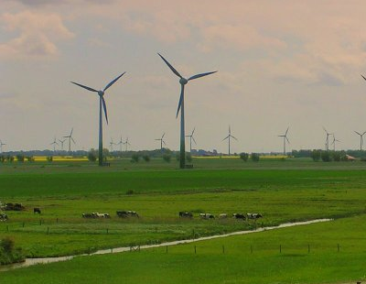
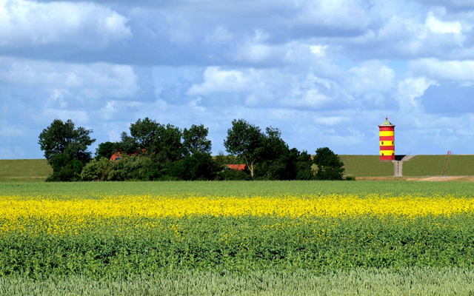
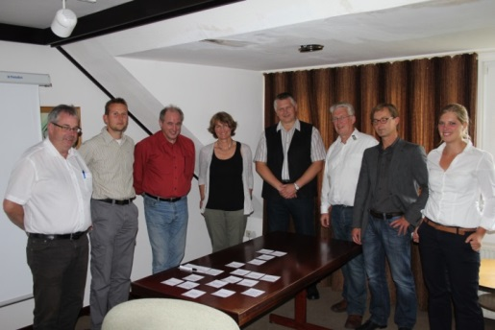
Conclusion
Contrary opinions, disagreements and trade-offs in the stakeholders´ interests are foci for discussions and consensus-building regarding future management processes.

Slide 16
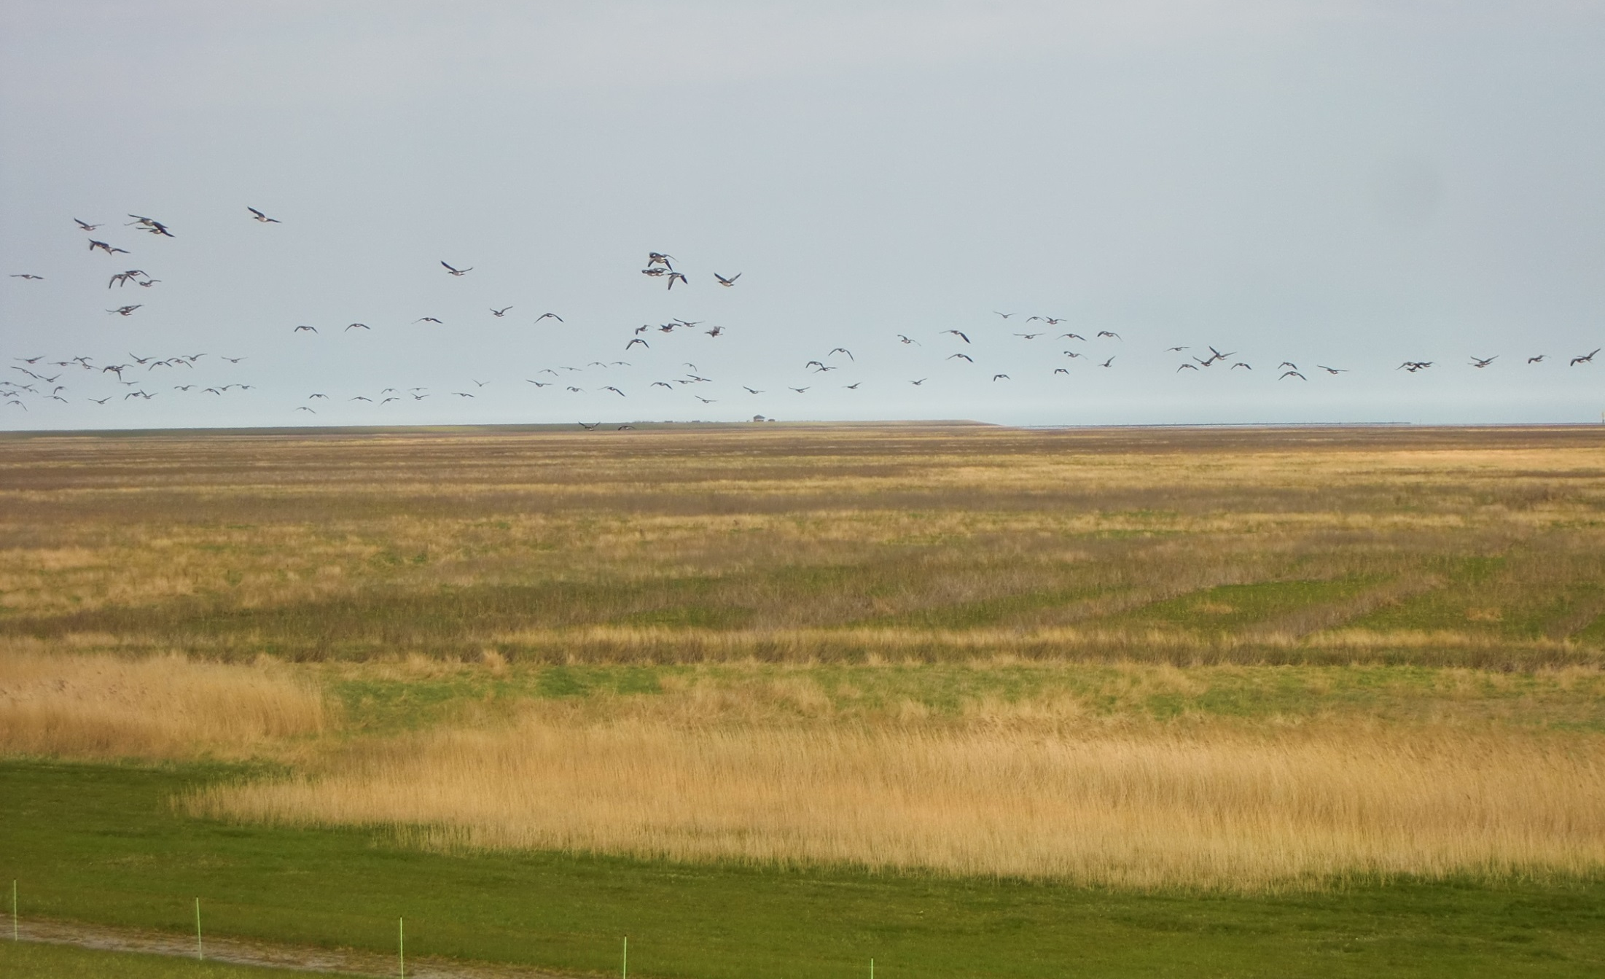
Thank you for your attention
Contact: leena.karrasch@uni-oldenburg.de
http://www.coast.uni-oldenburg.de/
http://www.comtess.uni-oldenburg.de/en/

