Slide 1
Formal Discourses and Perceptions of Risk
Katrina Brown
University of Exeter
On behalf of MAGIC team

Slide 2
Individual cognitive perceptions of Risk & Adaptation
Biophysical and social trends (sea level rise; floods; demographic change)
Reflection
Engagement & Situated Learning
Reliance on public adaptation
Climate Change
Risk Appraisal:
Perceptions of
Probability
Severity
Risk
experience appraisal
Choices
Adaptive actions and strategies
Outcomes
Adaptation Appraisal:
Perceptions of
- Adaptation efficacy
-Self-efficacy
-Adaptation costs
Cognitive biases
Objective Adaptive Capacity Resources such as time, money, knowledge & entitlements
Incentives
Adapted from Grothmann & Patt (2005)

Slide 3
Individual cognitive perceptions of Risk & Adaptation
Biophysical and social trends (sea level rise; floods; demographic change)
Reflection
Engagement & Situated Learning
Reliance on public adaptation
Climate Change
Risk Appraisal:
Perceptions of
Probability
Severity
Risk
experience appraisal
Choices
Adaptive actions and strategies
Outcomes
Adaptation Appraisal:
Perceptions of
- Adaptation efficacy
-Self-efficacy
-Adaptation costs
Cognitive biases
Objective Adaptive Capacity Resources such as time, money, knowledge & entitlements
Incentives
Adapted from Grothmann & Patt (2005)

Slide 4
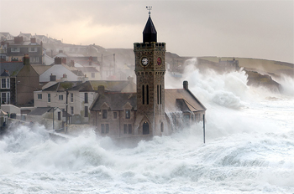
Cornwall Storms of 2013/2014
6 major storms
£20 million of damage
360 properties flooded
Disjuncture between long term planning and short term recovery
Different risk frames became important
Challenges policy windows as always positive
Maladaptation and unintended consequences

Slide 5
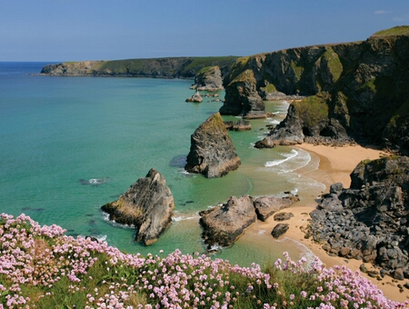
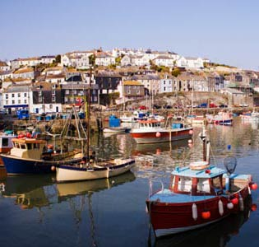
Risk frames
1. Command and control
‘The decisions that they make and the sort of energy that goes around that approach, you know it’s a command and control. They always want to control the issue, they’re not very happy with sitting with the greyness with ‘we’re just going to leave that to sit there for a little while’. So if you like, the structural methodology of managing emergency events doesn’t necessarily lend itself to the nuanced and long-term management of the environment.”
2. Economic bottom line
‘the evidence is tabled so, here is the cost of intervening, here is the potential cost if we don’t intervene, and then we have quite a few locations where we recommended it would not be economic to intervene and maintain a frontage….’

Slide 6
How do decision-makers approach risk?
Risk = Threat x Likelihood
Risk as multi-faceted
Risk is everywhere – life is risk, risk is life
Risk as subjective (personal)
Risk/opportunity trade-off

Slide 7
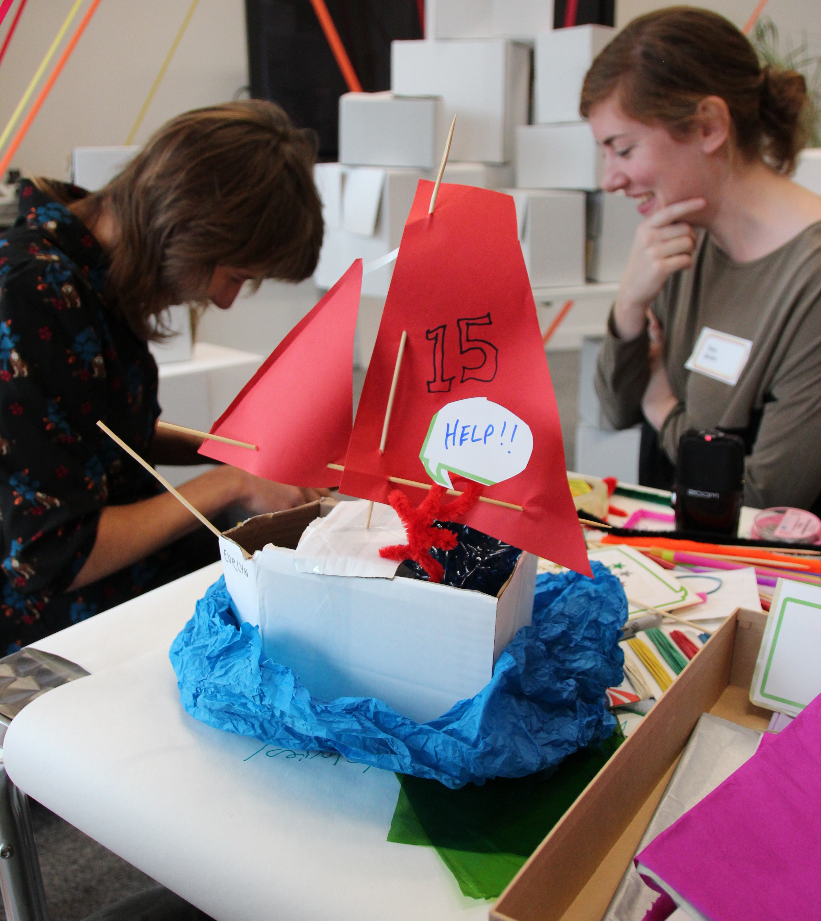
Investigating risk
Creative practices and ‘play’ to explore risk understandings
Examine personal and professional risk situations and decisions
Generate risk scenarios to identify risk frames
Do frames shift?

Slide 8
The seamlessness of the professional and personal
What is surprising?
“everyone cares deeply and is personally involved in the topic that they work with”
“that we all have similar issues”
What is useful?
“professional/ personal risk interdependencies”
“its not all bad – risk can be a positive thing”

Slide 9
Next steps
Continuing the dialogue with engaged stakeholders
Working at different scales
Extend and broaden engagement with wider range of actors
Duplicate methods at workshops at different sites

