Slide 1
Ecosystem service trade-off research: some lessons from stakeholder based research
Sander Jacobs, Francis Turkelboom, Berta Mártin-Lopez

Slide 2
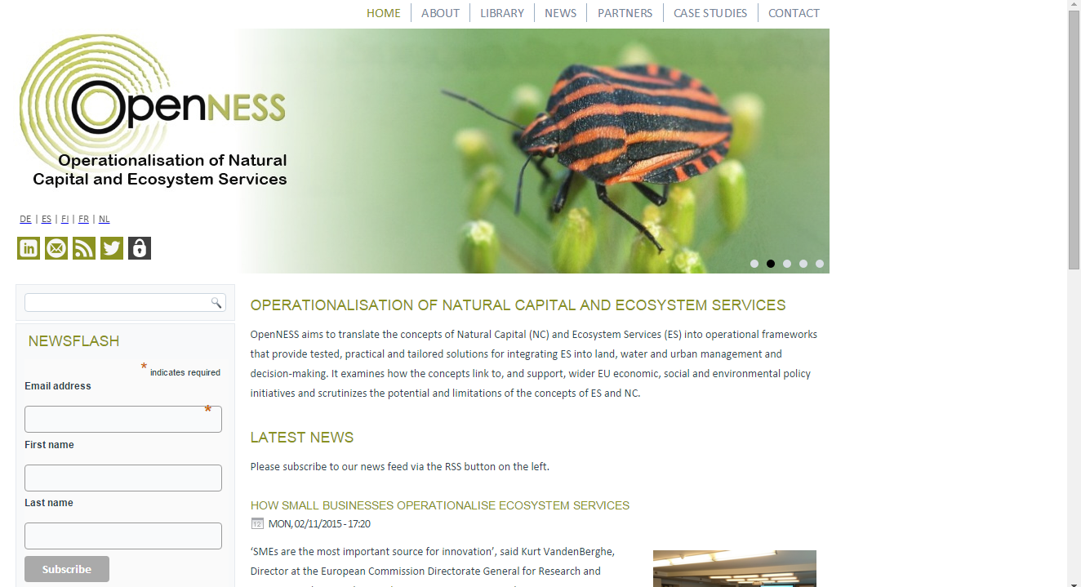
Critically matching science and practice
27 local case studies, mostly EU
Many methods and tools tested with local stakeholders
35 partners, Joint Research Activities, 30 Synthesis papers

Slide 4
The elegance of theory…
Trade-off [economy]: a consumer’s or institutions’ economic choice between options that are not combinable or produce externalities…
Trade-off [evolutionary ecology]: a species’ evolutionary ‘choice’ for an option that comes at the cost of direct fitness…
Trade-off [behavioral ecology]: an individual species’ choice between options that are not combinable or produce negative effects for other individuals or the ecosystem…
Trade-off [in ES literature]:
Bundles, interactions, spatial correlations, synergies,… amalgamation of terms
Spatial co-occurrence of ES supply proxies
One-on-one interactions explained functionally
trade–off noun \ˈtrād-ˌȯf\
1: a situation in which you must choose between or balance two things that are opposite or cannot be had at the same time.
2: a balancing of factors all of which are not attainable at the same time

Slide 5
…versus the messiness of real-life
Trade-offs between (groups of) people
Trade-offs are highly variable between contexts
Trade offs between different values
Trade-offs within single services
Trade-offs between ES and non-ES
synergies often go unnoticed…

Slide 6
How can I complete, correct and communicate my theoretical concept?
How can I render my concept useful and helpful?
…Is it even useful…?
What is she even talking about?
Trade-offs between ES – work in progress
Framework & Definition
Operational Typology
Integrate multiple Values

Slide 7
1. Developing a definition framework
Supply
Demand
Ecological
Physical
Geographical
Trade-offs:
“Which services are supplied where?”
Individual
Social
Institutional
Distributional
Trade-offs
“Who benefits, who decides?”
Ecosystem Services ‘flow’
=> “Bundles”

Slide 8
1. Developing definition framework
Use* Choices
Trade-off between USE of a service and other or the same services’ supply, demand or use.
“HOW are ES realized?”
Spatial scale
Temporal scale
Institutional scale
Demand
Supply
Impacts
Benefits
Ecological
Physical
Geographical
Trade-offs:
“Which services are supplied where?”
Individual
Social
Institutional
Distributional
Trade-offs
“Who benefits, who decides?”
(=> “Mismatch”)
Factors
Factors
(=> “Bundles”)

Slide 9
A bundle is ‘a set of associated ecosystem services that are linked to a given ecosystem and that usually appear together repeatedly in time and/or space’.
A trade-off is ‘a situation where the use of one service directly decreases the benefits supplied by another or the same service, now or in the future’
http://www.openness-project.eu/library/reference-book
Synthesis papers:
16 published
4 in revision
8 out for consultation

Slide 10
2. co-creating an operational typology

Slide 11
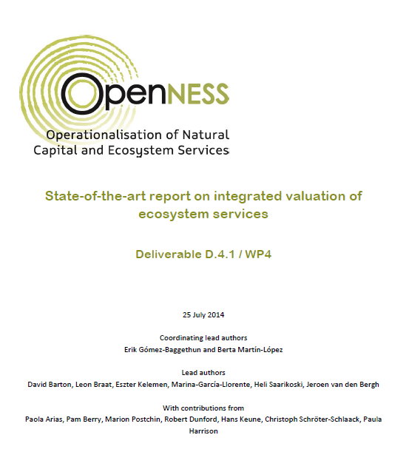
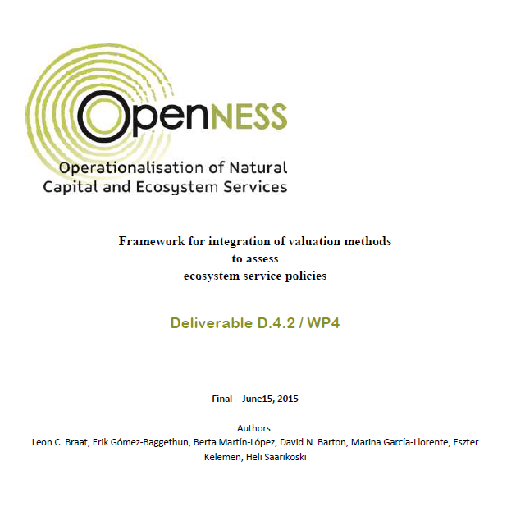
3. Applying integrated valuation
WP 4 Integrated Valuation
Deliverable 4.3
(Under Construction)

Slide 12
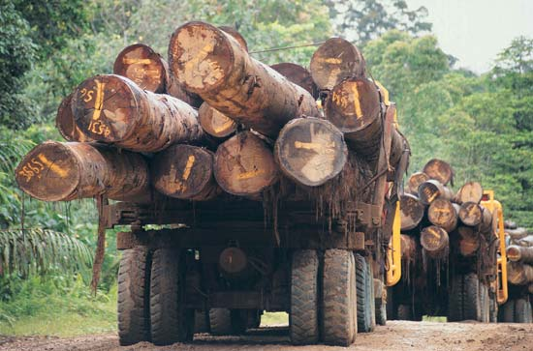
3. Applying Integrated Valuation

Slide 13
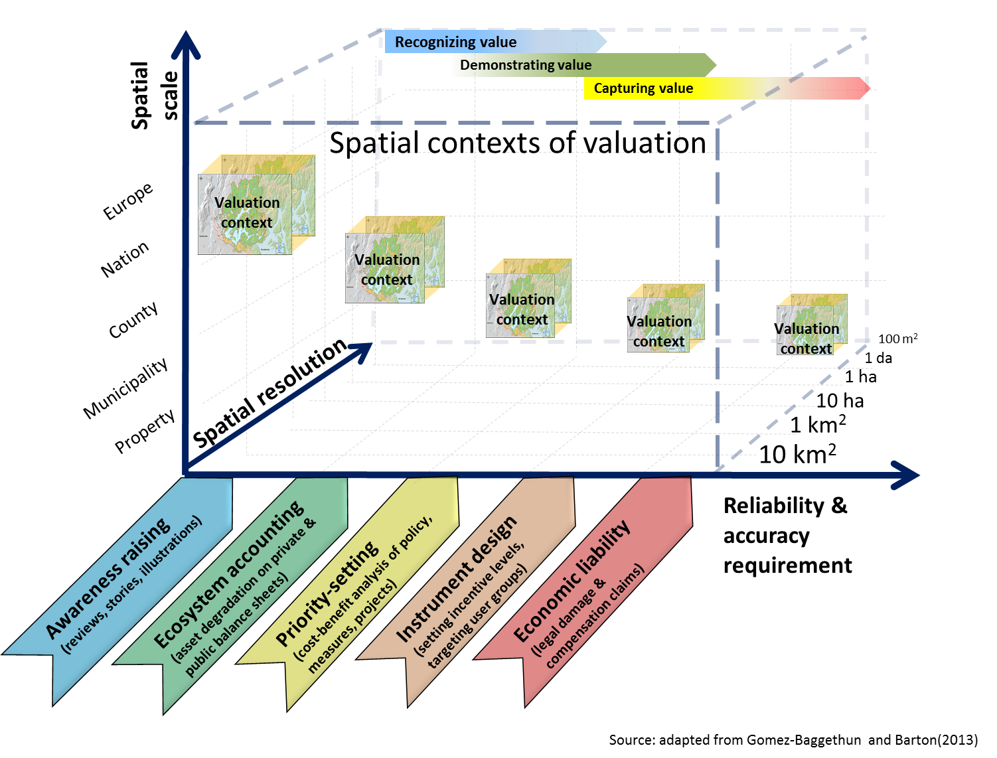
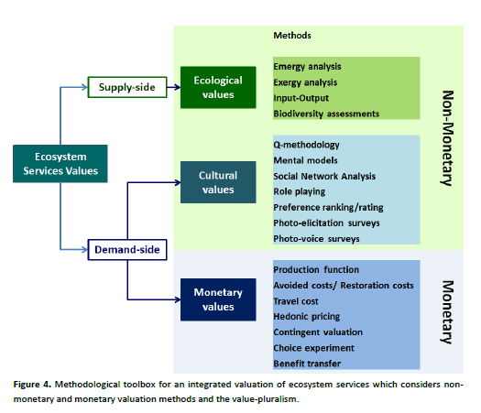
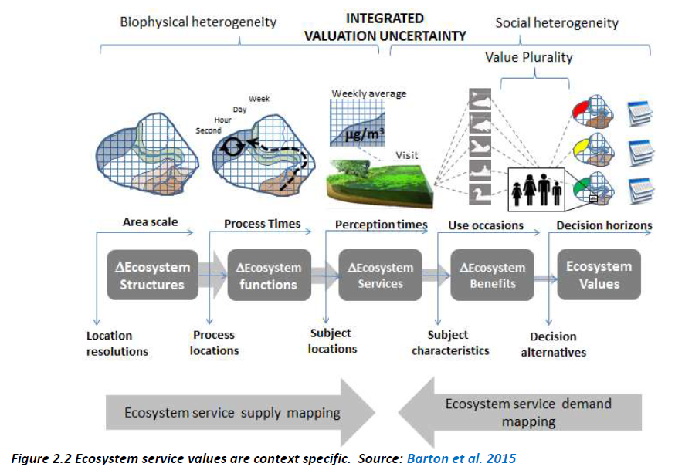
3. Applying integrated valuation
GOALS determine REQUIREMENTS
Geographical scale
Spatial resolution
Reliability and accuracy
PLURAL VALUES
Require
PLURAL METHODS
ES-VALUES
are
CONTEXT SPECIFIC

Slide 14
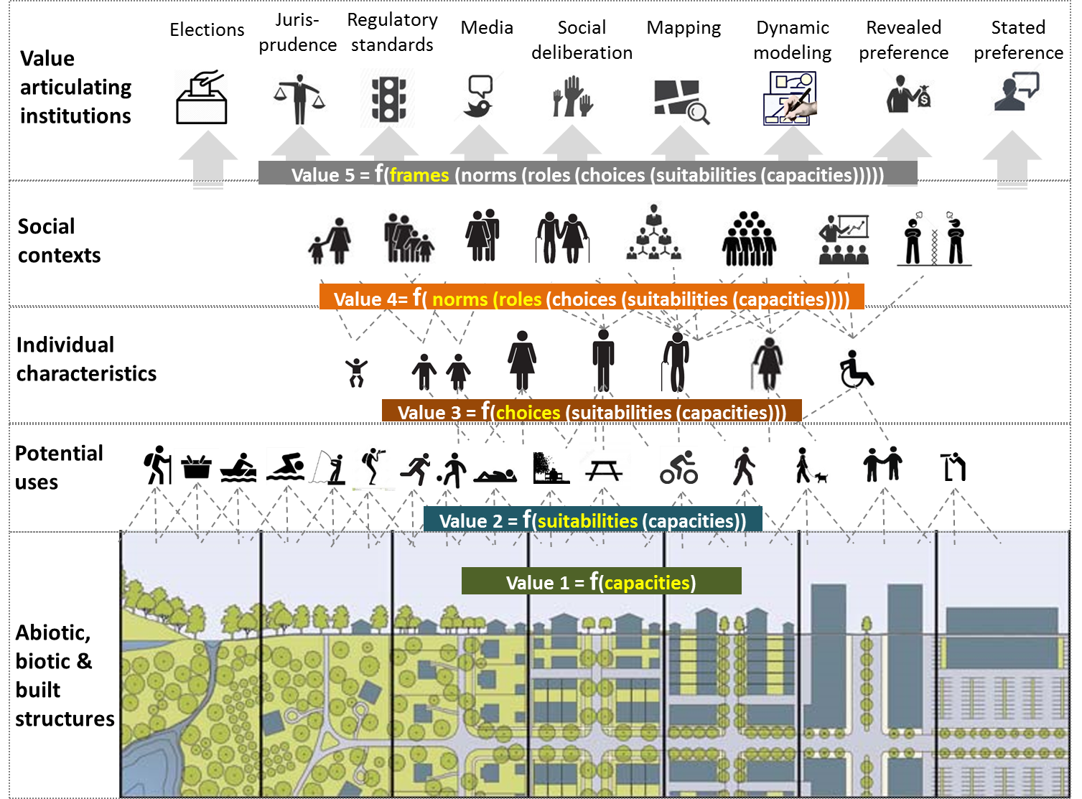
3. Applying integrated valuation
Source: Barton based on
landscape illustration by
Duany Plater-Zyberk & Company
Notes:
Context density and diversity – value plurality

Slide 15
3. Applying integrated valuation
How integrated does my valuation need to be?
How integrated is it?
What are the methodological requirements following from this?
What is the consequence for validity of my outcomes?
What is the ‘operating space’ of my outcomes?

Slide 16
stakeholder-based methods in trade-off research
Focused definition of trade-off, synergy, bundle,…
Operational typology for application
Tested methods to capture and integrate multiple values

Slide 17
Happily ever after “operationalization”?
How does management affect ES trade-offs?
Can we identify leverage points where a small change in management can reduce ES trade-offs?
How to reduce the risk of policy failure due to ES trade-offs and the uncertainty they entail?
How can power asymmetries be addressed to influence the handling and resolution of ES trade-offs?
How do we deal with non-ES (e.g. jobs, infrastructure)?

Slide 18
http://www.es-partnership.org/esp/81931/5/0/50
http://www.journals.elsevier.com/ecosystem-services/call-for-papers/special-issue-on-integrated-valuation-of-ecosystem-services/
http://www.openness-project.eu/
http://www.sciencedirect.com/science/book/9780124199644
http://www.ipbes.net/images/documents/plenary/third/information/INF_7/IPBES_3_INF_7.pdf
http://www.openness-project.eu/sites/default/files/Deliverable%204%201_Integrated-Valuation-Of-Ecosystem-Services.pdf
EU FP7 OpenNESS Project Deliverable 4.1., Gómez-Baggethun, E., B. MartínLópez, D. Barton, L. Braat, H. Saarikoski, Kelemen, M. García-Llorente, E., J. van den Bergh, P. Arias, P. Berry, L., M. Potschin, H. Keene, R. Dunford, C. Schröter-Schlaack, P. Harrison. State-of-the-art report on integrated valuation of ecosystem services. European Commission FP7, 2014.
Jacobs, S., Burkhard, B., Van Daele, T., Staes, J., Schneiders, A., 2014. “The Matrix Reloaded”: A review of expert knowledge use for mapping ecosystem services. Ecol. Modell. 295, 21–30. doi:10.1016/j.ecolmodel.2014.08.024
Boeraeve, F., Dendoncker, N., Jacobs, S., Gómez-Baggethun, E., Dufrêne, M., 2014. How (not) to perform ecosystem service valuations: pricing gorillas in the mist. Biodivers. Conserv. doi:10.1007/s10531-014-0796-1
Dendoncker, N., Keune, H., Jacobs, S., Gomez-Baggethun, E., 2014. Inclusive Ecosystem Service Valuation, in: Jacobs, S., Dendoncker, N., Keune, H. (Eds.), Ecosystem Services: Global Issues, Local Practices. Elsevier, New York, pp. xix–xxviii.
…

