Slide 1
Operational ES trade-off typology

Slide 2
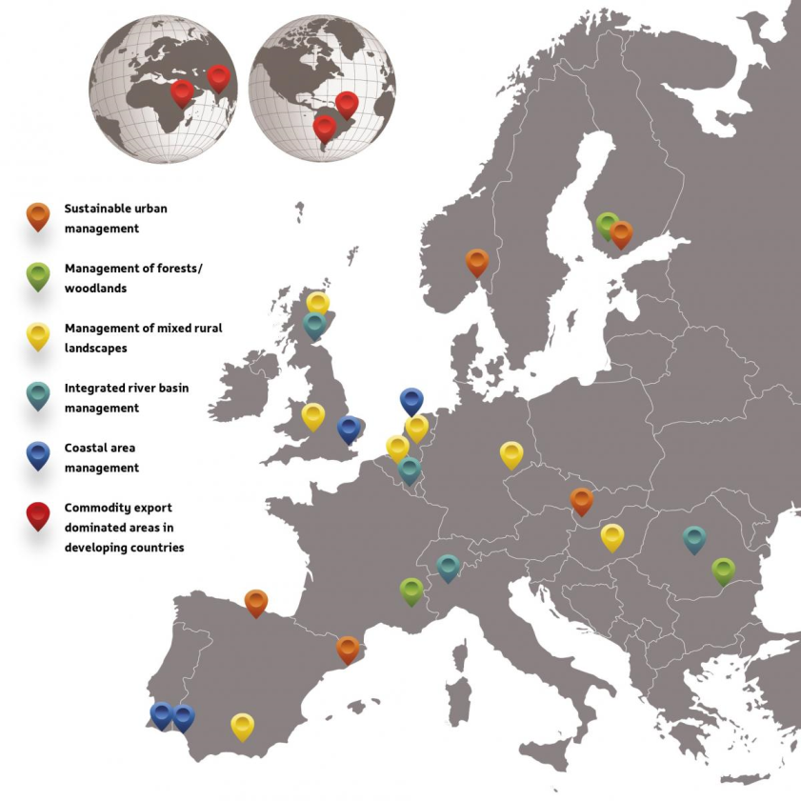
An operational ES trade-off typology?
What? Start from choices that have to be made by planners/land-users/decision makers/...
Why?
Checklist of possible ES trade-offs
Detect and understand (potential) stakeholder conflicts
Common solutions for each trade-off type?
Specific research needs for each trade-off typology?
How?
Learning from practise: 27 case studies
http://www.openness-project.eu/

Slide 3
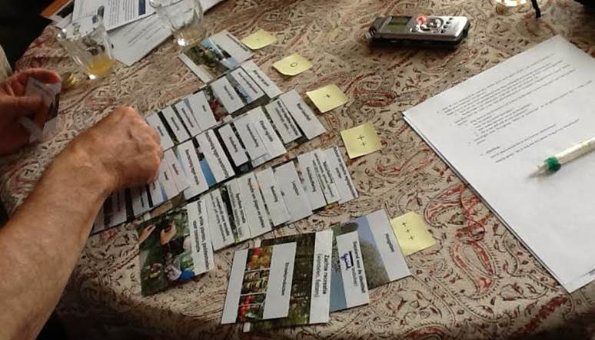
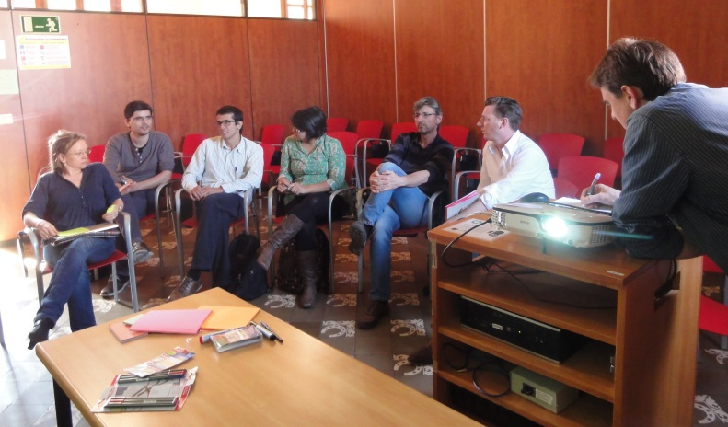
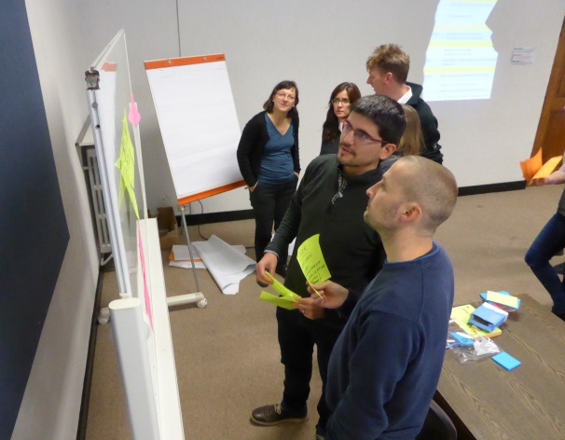
Iterative process for building an operational ES trade-off typology
De Cirkel Case Study
OpenNESS Barcelona workshop
OpenNESS Leuven workshop
Focus: Competing activities
1 | Spatial competition
2 | Activity incompatibility
3 | Activity side-effects
Focus: Use of resource(s)/ESS
4 | Overuse
5 | Overharvesting
6 | Depletion supporting ESS
Focus 1: Choices
1 | Competition for investment funds
2 | Choice between different instruments
Focus 2: Competing land-use
3 | Spatial competition
Focus 3: Competing activities
4 | Activity incompatibility
5 | Activity side-effects
Focus 4 : Use of one ES
6 | ES via different strategies
7 | Overuse
8 | Overharvesting
9 | Depletion supporting ESS

Slide 4
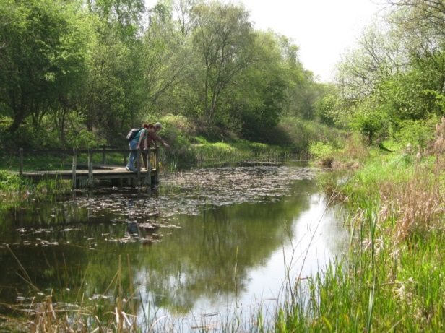
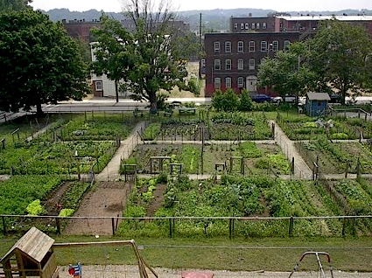
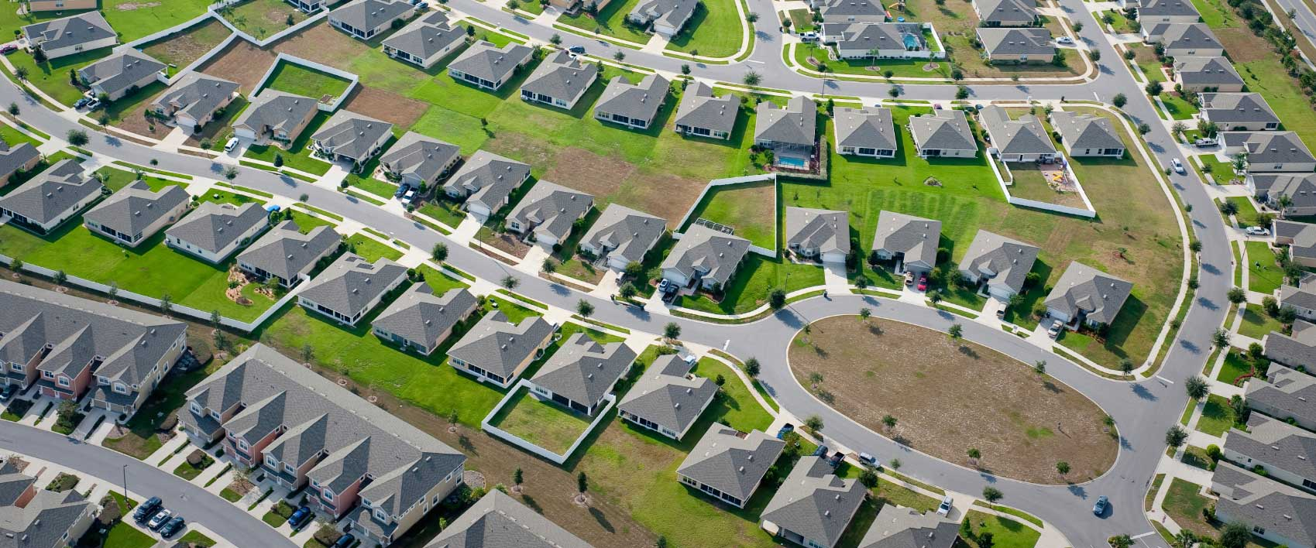
Cluster 1: Choice in land-use (spatial competition)

Slide 5
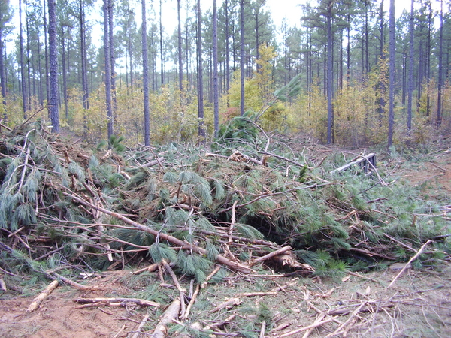
Cluster 2: Choices in management
Common Milkweed in Hungary
(Asclepias syriaca)

Slide 6
Cluster 3: Choices in regulating (outdoor) activities

Slide 7
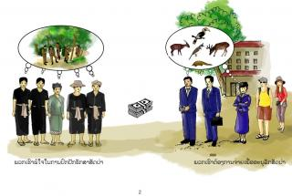
Cluster 4: Choice of legal regimes
“To PES or not to PES”

Slide 8
Cluster 5: Investment choices between ES and non-ES
?
?
?
?

Slide 9
Provisional operational ES trade-off typology
Choice:
Different goals
Same goal with or different means
Impact:
Different ES bundles
Combinations
Scale effects

